Slide 1
USING THE DILATOMETER TEST TO MAKE ACCURATE SETTLEMENT PREDICTIONS
Roger A. Failmezger, P.E., F. ASCE, D. GE
Geo-Chicago Lecture Series
May 10, 2019

Slide 2
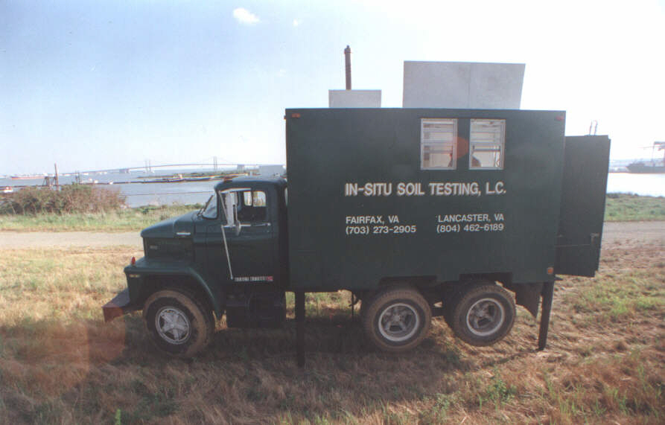
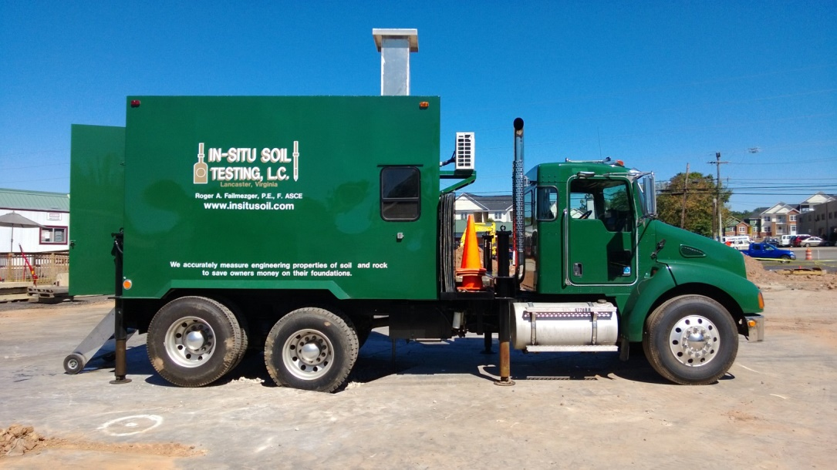
DMT Push Truck—First in North America
Replaced carrier after hydraulic brakes failed when leaving a site
1971 Dodge Carrier—Ran 55mph Downhill
2006 Kenworth Carrier with Automatic Transmission

Slide 3
Geotechnical Engineers?
Geotechnical engineers are essentially predictors
—the better that we can predict the outcome
—the better our designs are
Good Predictions => Good Engineering

Slide 4
Outline
Performance and Financial Failures
  Why we need accurate measurements and design models
Compare Different Tests and Settlement Prediction Methods
  Standard Penetration Test
  Cone Penetrometer Test
  Laboratory Consolidation Test
  Pressuremeter Test
  Dilatometer Test
Case Studies

Slide 5
Types Of Failures
Performance Failure
  Outcome has an undesired consequence
Financial Failure
  Poor design model and parameter evaluation creates overly costly design because of high uncertainty/lack of knowledge
    Settlement Evaluation
      Need Static Deformation Test => Dilatometer, Pressuremeter, Lab Consolidation Test
Never Want the Test to be Your Source of Uncertainty
Accurate Design Balances Performance and Financial Failures– Select the Appropriate Probability of Success

Slide 6
Fundamentals of Probability
Mathematicians have presented probability theory as being much more complicated than it really is—and thus we shy away from using it
The event always occurs—therefore its probability is 100%
  Flip a coin—it will land as either a head or tail
  Engineering design—either a successful outcome or undesired outcome
Engineering probability distribution curves tend to be bell-shaped with a more likely chance of outcome occurring near the center
Total area beneath the probability curve must always equal 1.00 or 100%
  Figure out how much is in the success zone and how much in the failure zone
    Use trapezoidal method to compute the areas
    Probability of Success + Probability of Failure = 1.00

Slide 7
Probability of Success
Because of uncertainty, design solution is not deterministic, but rather probabilistic solution based on a bell-shaped curve
Bell-shaped curve is defined knowing:
  Average Value
  Standard Deviation
  End Limits
End limits for normal probability distribution curve are +/-∞ and for log-normal curve are zero to +∞ -- not realistic
Beta probability distribution curve gives engineer best solution—Engineer chooses the end limits!
Probability of success is the area under curve in the success zone

Slide 8
Same Soil—Different Tests and Modeling

Slide 9
Lack of Knowledge→More Expensive Design Probability curves shift to the right for same Success

Slide 10
One certainty with Geotechnical Engineering: If you don’t make accurate measurements and use good models, you will certainly have financial failure!
If owner discovers that you are designing for a financial failure of 79%, then you will lose client!

Slide 11
Plot Average Factor of Safety and its Standard Deviation to Determine Probability of Success
Factor of Safety Design Chart

Slide 13
Settlement Design Chart

Slide 14
Shallow Foundation Design
Provided that the footing is sufficiently wide, settlement, rather than bearing capacity, controls the design
Often, engineers design all footings with the same bearing pressure as the “worst case scenario” footing
Even if settlement predictions are accurate, other footings settle less than the “worst case” one, resulting in differential settlement

Slide 15
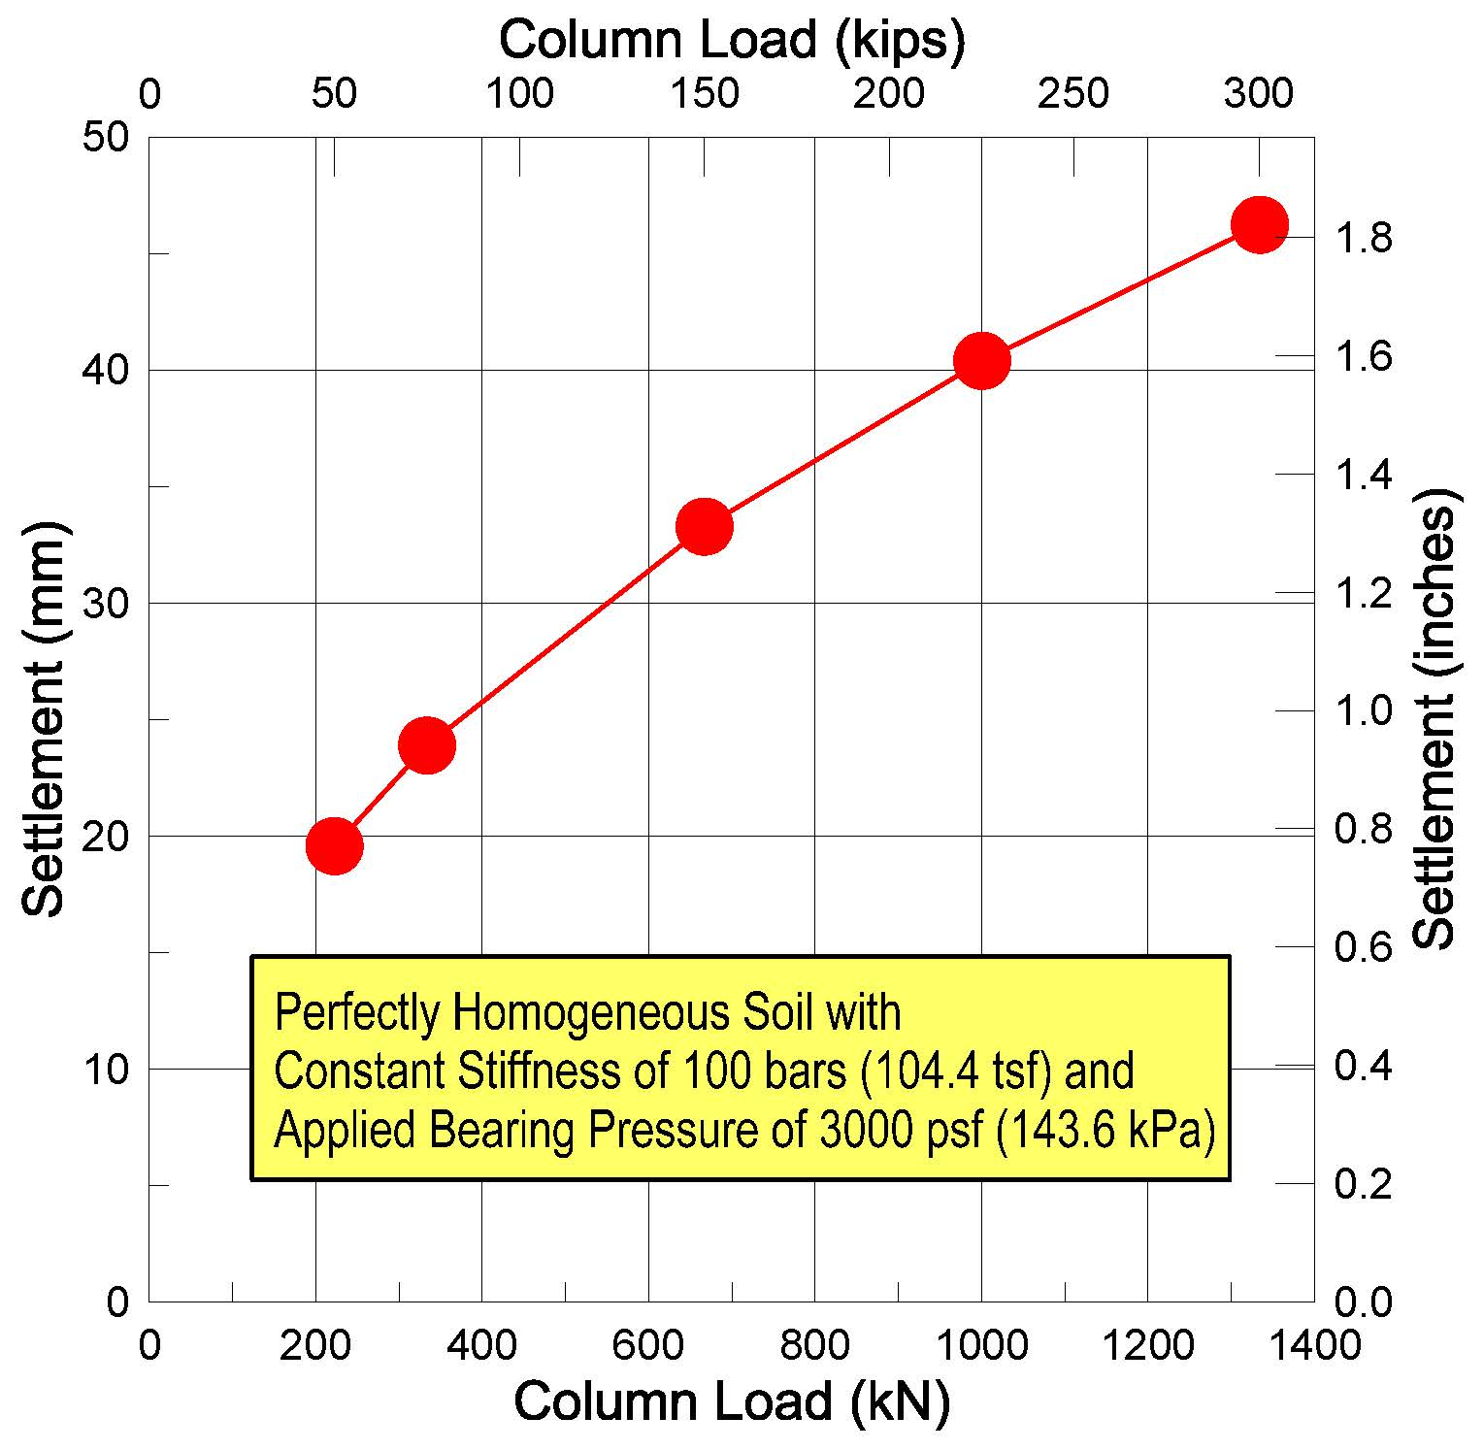
Often Engineers incorrectly recommend one allowable bearing pressure for entire site

Slide 16
Shallow Foundation Design (cont.)
Goal is to minimize the differential settlement by designing each footing to settle the same amount
Dilatometer tests performed at close intervals can be used for accurate settlement predictions
Dilatometer test is a calibrated static deformation test

Slide 17
Contouring
Because soundings are only performed at a finite number of locations, engineer must interpret what will likely occur between locations
Contouring is a numerical interpretation that can use mathematical algorithms, such as kriging and others
Contour maps may show holes, peaks, ridges or valleys—these anomalies may be areas for additional testing for better design

Slide 18
Numeric Example

Slide 19
Contour Map Showing Settlement Across the Site

Slide 20
Comparing different tests for settlement analyses

Slide 21
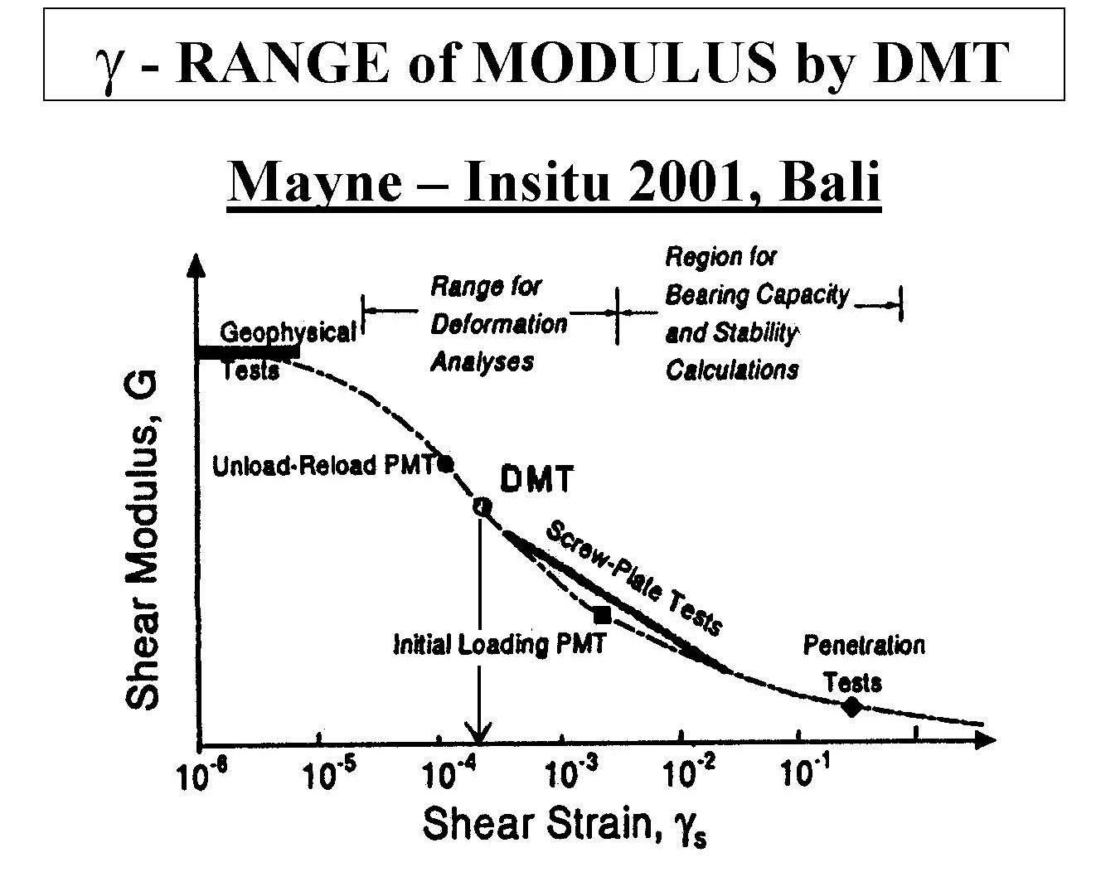

Slide 22
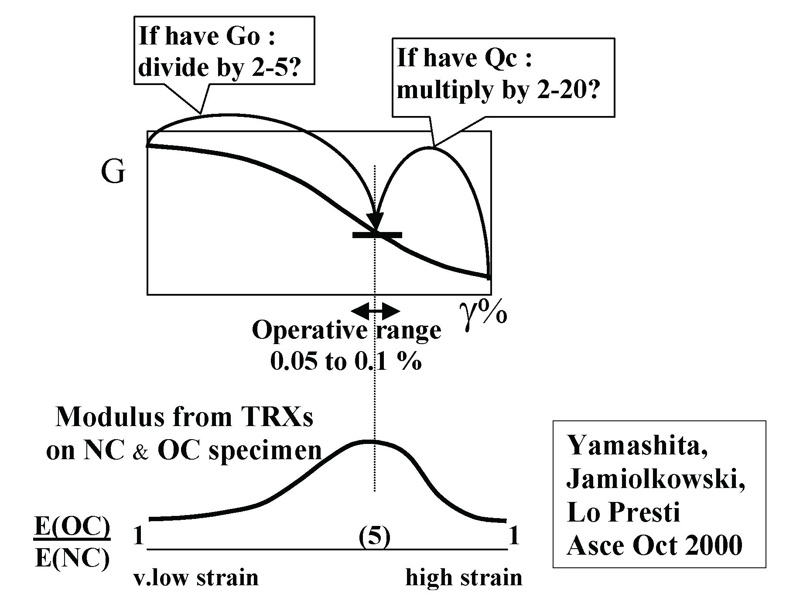
Importance of stress history
(After Marchetti, 2001)

Slide 23
Standard Penetration Test
Dynamically drive a 2-inch diameter split barrel sampler with 140 pound hammer falling 30 inch, counting the number of blows
While the inspector meticulously counts the number of blows, the energy that the hammer generates is often not calibrated and varies significantly

Slide 24
ADSC-ASCE-FHWA Load Tests at GT
Assumed ER = 85%
ER = 62%
ER = 42%
(After Dr. Paul Mayne, 2019)

Slide 25
ADSC-ASCE-FHWA Load Tests at GT

Slide 26
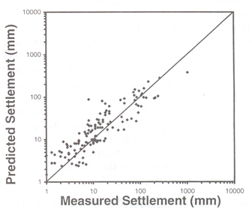
Standard Penetration Test
Best case scenario for SPT:
Using N₆₀ values in sand
Predicting modulus from N₆₀-value has wide range of correlation factors
Primary Disadvantages
the energy not being measured
dynamically penetrating the soil
the soil being strained to failure
remolding of the soil
Financial Failure Will Certainly Occur!
Coeff. Of Var. =0.67 – quite high
For 95% certainty sett less than 25 mm,
then ave sett =7.5 mm
(After Burland and Burbridge, 1985)

Slide 27
Cone Penetration Test
Quasi-statically hydraulically push a 10 cm² projected tip probe into the soil at a constant rate of 2 cm/sec.
A computer measures and records data from the calibrated electronic sensors at depth intervals of 1 to 5 cm and plots their values on the screen.
Constrained deformation modulus is computed by multiplying the tip resistance by an α factor.

Slide 28
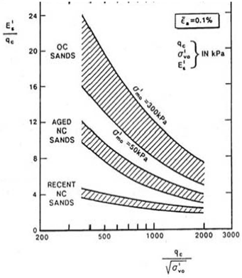
Cone Penetration Test
Primary Disadvantages
strains the soil to failure
remolds the soil
stress history unknown
Ground Improvement changes α factor
Scatter for α factor to obtain deformation modulus from tip resistance
Need site specific correlation values to get modulus
M = (α)(q_{T})

Slide 29
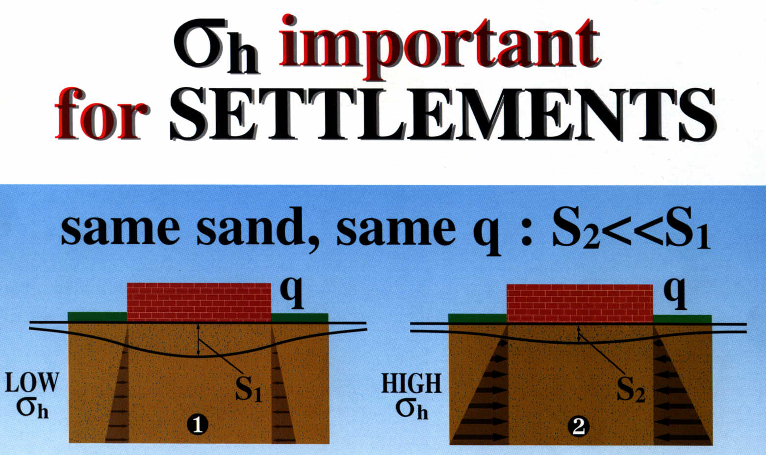
(After Marchetti, 1996)

Slide 30
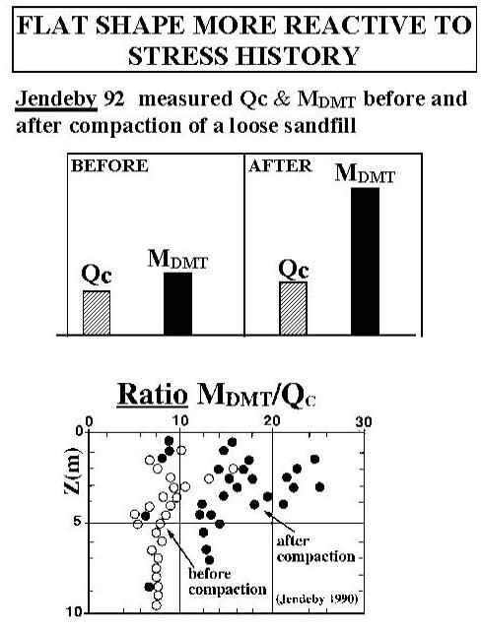
= α factor
α factor not constant: increases with ground improvement due to increases in lateral stresses
(After Marchetti, 1996)

Slide 31
Lab Consolidation Test
Advantages:
With high quality sample can measure the deformation properties
Disadvantages:
Too costly and time consuming to perform numerous tests
Difficult to test cohesionless soil

Slide 32
Pressuremeter Test
Advantages:
Static deformation test
Empirical design method based on large database of case studies
Can test dense/hard soils when loads are high
  Slotted casing for gravel formations
Disadvantages:
Test takes 1+ hours to perform
Vertical spacing 1+ meter
  Can miss thin soft layers

Slide 33
Dilatometer Test
Advantages:
Economical to perform numerous tests at close intervals
Strains soil to intermediate levels similar to the structure
Measures the effect of soil stress history
Disadvantages:
Gravel causing point loads against membrane or damaging membrane

Slide 34
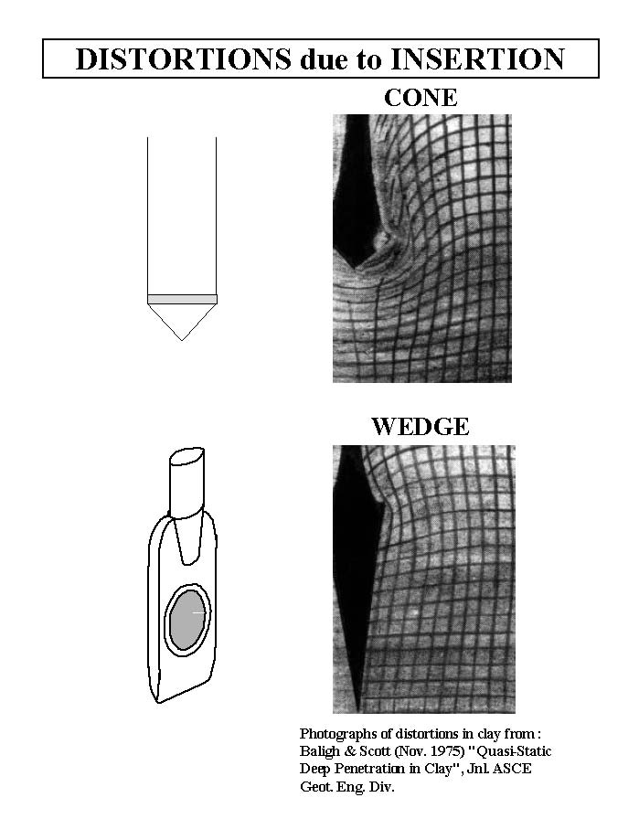
Dilatometer penetration causes has much smaller shear and volumetric strain to soil
Shape of dilatometer blade disturbs the soil less than conical shape

Slide 35
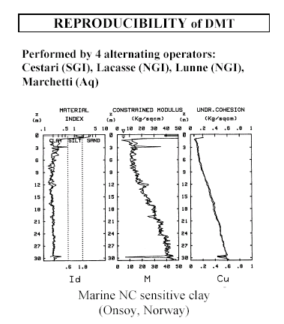

Slide 36
Dilatometer Testing Pointers
Pressurization rate should be relatively slow near “A” and “B” readings so that pressure in blade is same as shown on gauge
Thrust measurements can alert operator of potential shifts in “A” and “B” readings when comparing with previous readings
Low thrust readings are indicative of soft soils

Slide 37
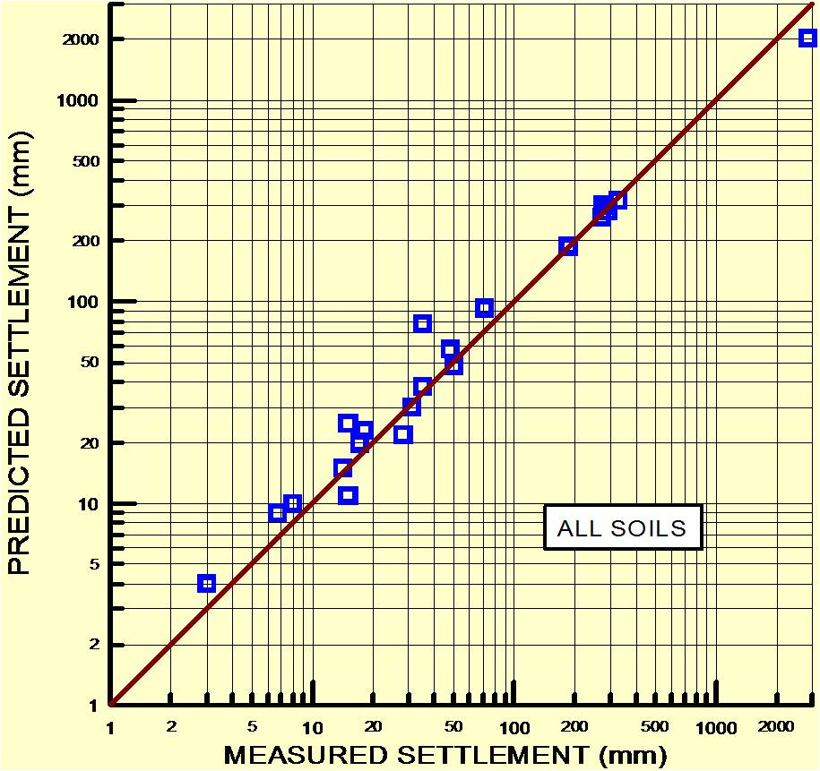
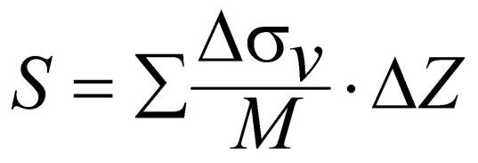
Coeff. Of Var. = 0.18
Quick clayey silt
Niche silt?
Schmertmann, 1986 and Hayes, 1986

Slide 38
DMT Settlement Analysis Factors
Because constrained deformation modulus is in the denominator of settlement equation, low values have a much greater impact than high values
By performing tests at close interval spacing, the engineer can detect thin soft layers, which often control design
In very soft layers, DMT at 10-cm intervals provide better layer definition and more accurate settlement predictions

Slide 39
Settlement Accuracy
Ratio of predicted/measured settlement = 1.15; coefficient of variation = 0.29
If eliminate data from quick silts and driving DMT blade, predicted/measured ratio = 1.06; coefficient of variation = 0.18

Slide 40
Case Studies

Slide 41
White Flint WMATA Site
6 dilatometer soundings were performed to top of decomposed rock
Schmertmann’s (1986) method was used to predict settlement at each sounding
DMT were performed at 20-cm depth intervals and each test was considered a layer for the analyses

Slide 42
Column Load | Footing Width | Applied Bearing Pressure |  | Predicted Settlement
(kips / kN) | (ft / m) | (ksf / kPa) | Sounding | (inch / mm)
850 / 3780 | 10.5 / 3.2 | 7.71 / 369 | D-5 | 0.24 / 6.1
850 / 3780 | 10.5 / 3.2 | 7.71 / 369 | D-6 | 0.37 / 9.4
1000 / 4448 | 13 / 4 | 5.92 / 283 | D-1 | 0.70 / 17.8
1000 / 4448 | 11 / 3.4 | 8.26 / 396 | D-2 | 0.33 / 8.4
1400 / 6227 | 15 / 4.6 | 6.22 / 298 | D-1 | 0.84 / 21.3
1400 / 6227 | 13 / 4 | 8.28 / 397 | D-2 | 0.38 / 9.7
1400 / 6227 | 13 / 4 | 8.28 / 397 | D-3 | 0.57 / 14.5
1400 / 6227 | 13 / 4 | 8.28 / 397 | D-4 | 0.82 / 20.8
1400 / 6227 | 13 / 4 | 8.28 / 397 | D-5 | 0.40 / 10.2
1400 / 6227 | 13 / 4 | 8.28 / 397 | D-6 | 0.51 / 13.0
1500 / 6672 | 16 / 4.9 | 5.86 / 281 | D-1 | 0.84 / 21.3
1500 / 6672 | 13.5 / 4.1 | 8.23 / 394 | D-2 | 0.38 / 9.7
1500 / 6672 | 13.5 / 4.1 | 8.23 / 394 | D-5 | 0.42 / 10.7
1500 / 6672 | 13.5 / 4.1 | 8.23 / 394 | D-6 | 0.53 / 13.5
2000 / 8896 | 18 / 5.5 | 6.17 / 296 | D-1 | 0.98 / 24.9
2000 / 8896 | 16 / 4.9 | 7.81 / 374 | D-2 | 0.41 / 10.4
2000 / 8896 | 16 / 4.9 | 7.81 / 374 | D-3 | 0.72 / 18.3
2000 / 8896 | 16 / 4.9 | 7.81 / 374 | D-4 | 0.89 / 22.6
2000 / 8896 | 16 / 4.9 | 7.81 / 374 | D-5 | 0.50 / 12.7
2000 / 8896 | 16 / 4.9 | 7.81 / 374 | D-6 | 0.57 / 14.5
Summary of Settlement Analyses

Slide 43
Sensitive and conservative owner satisfied with design

Slide 44
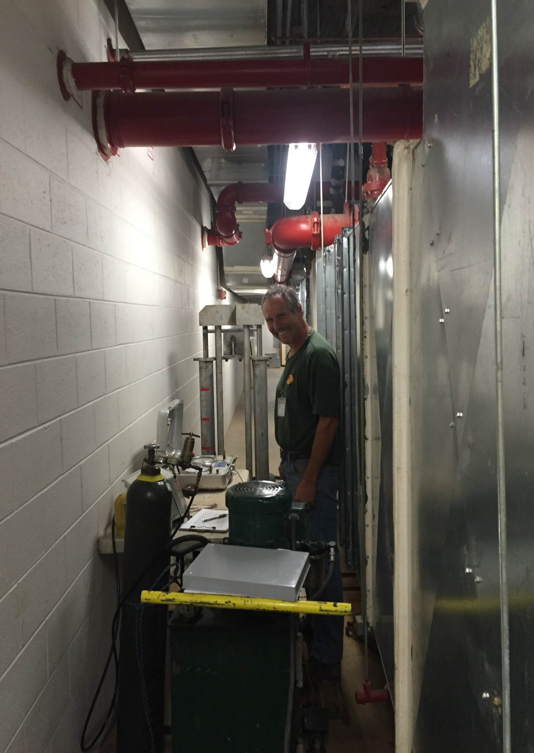
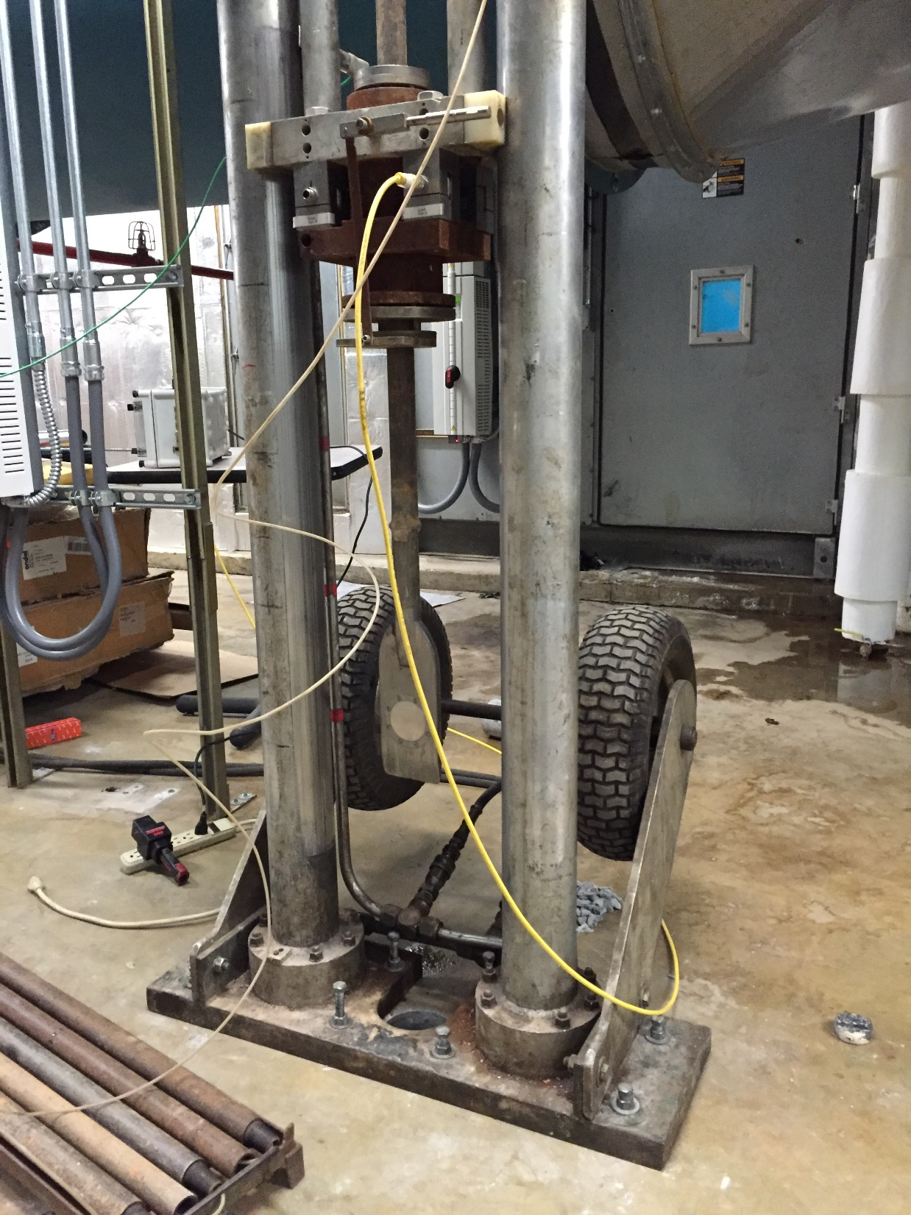
Lynchburg Hospital
Performed 20 dilatometer test soundings adjacent to existing footings inside Lynchburg Hospital to compute additional settlement for proposed increase from 3 to 5 stories. Found only 4 out of 20 columns will need underpinning!

Slide 45
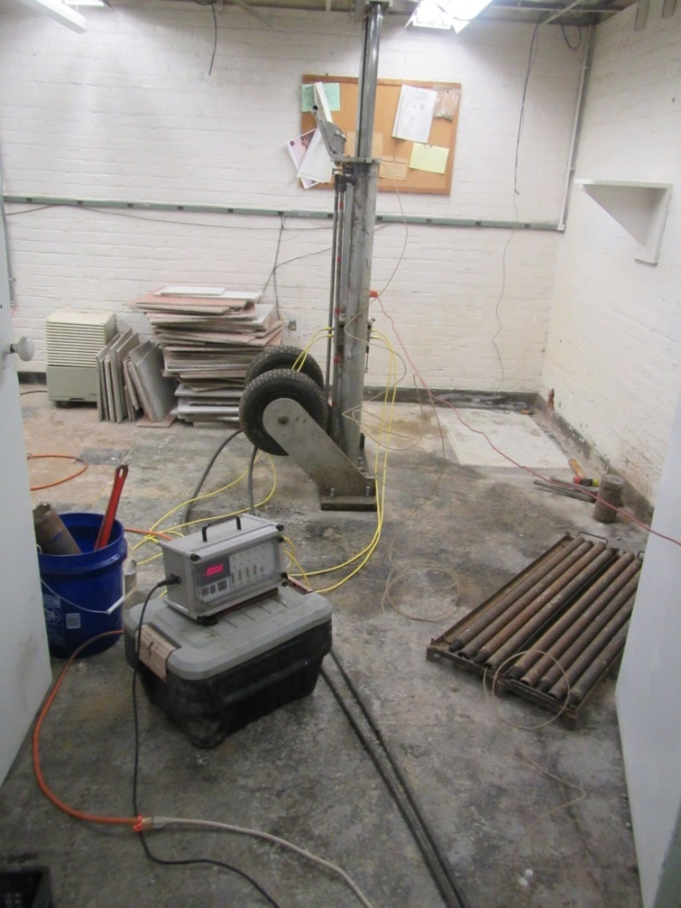
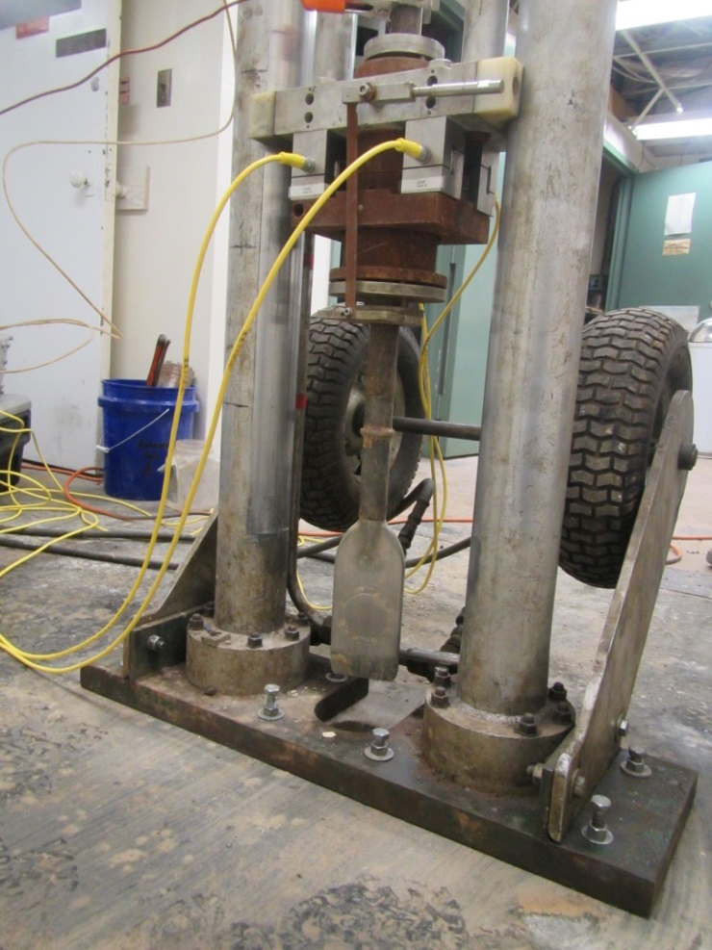
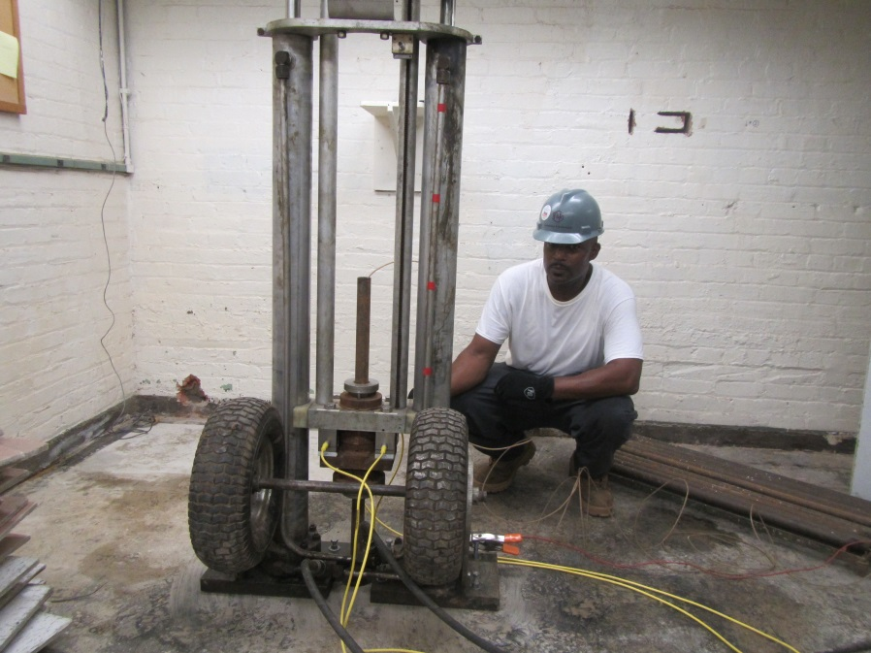
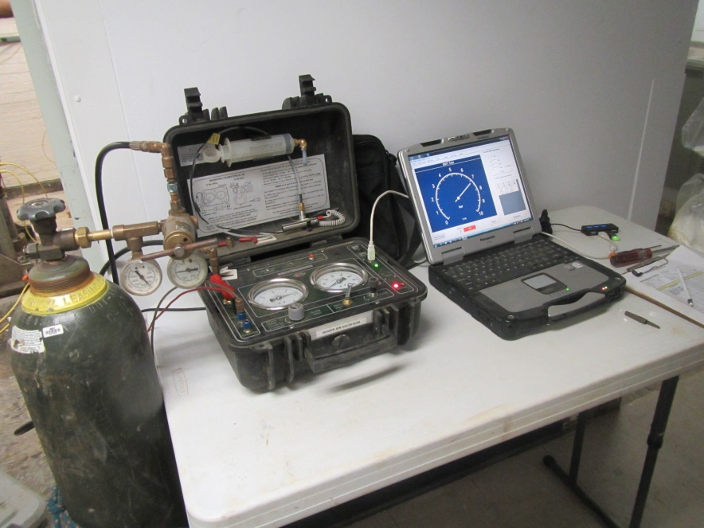
Performed dilatometer test soundings inside existing Museum of American Educator to determine which existing footings needed underpinning for new loads

Slide 46
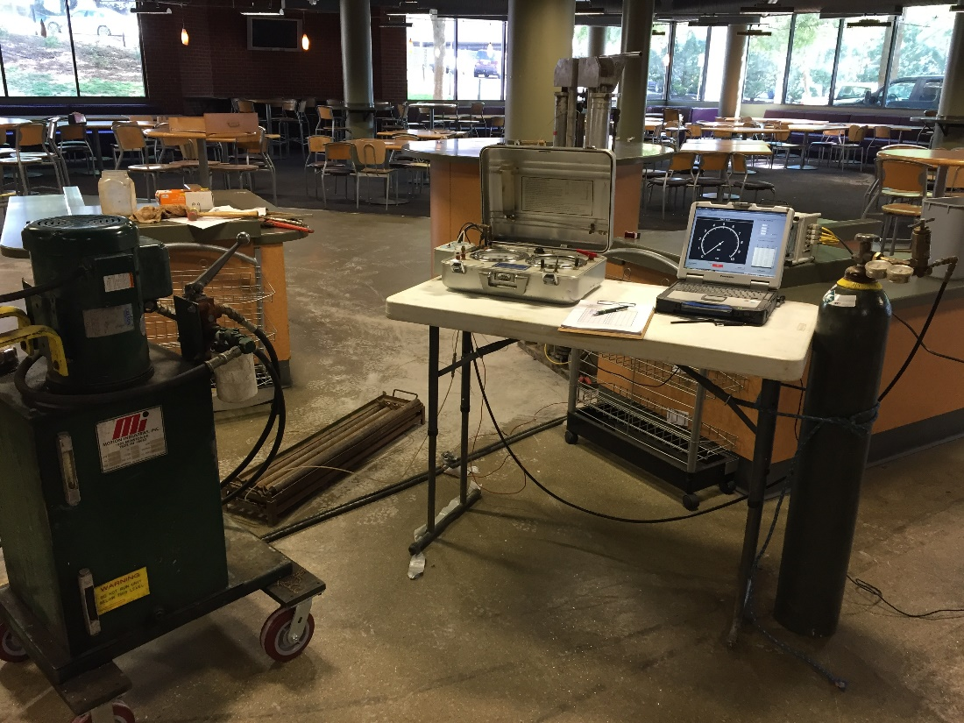
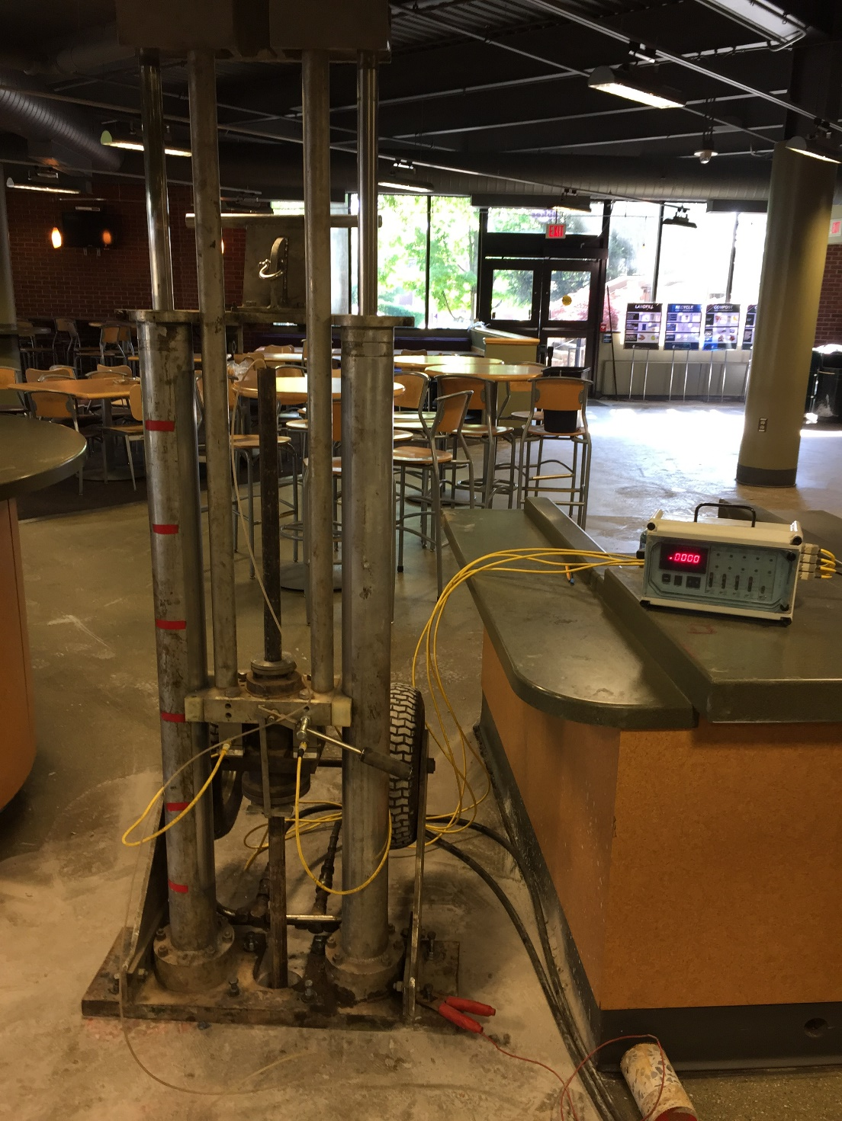
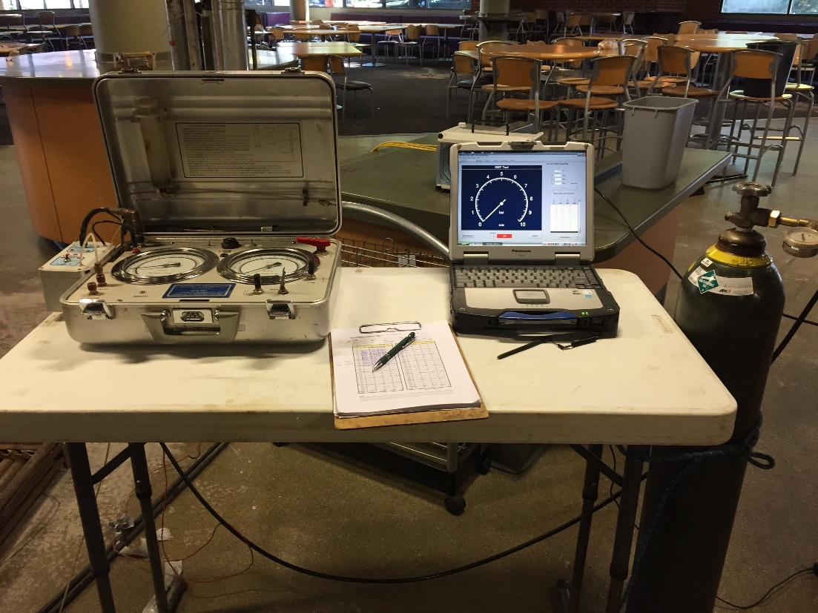
James Madison University—Phillips Hall
Tested every column location for new building

Slide 47
Ocean City Warehouse Buildings
Three adjacent sites were investigated
  Two outside ones with DMT by one consultant
  Middle one with SPT by different consultant
  Similar Loads for the three structures
Two Sites with DMT predicted ~0.5 inches of settlement for shallow spread footings
Embankment load test showed 0.5 inches
Consultant for Middle Site recommended stone column ground improvement
  Wasted ~$800,000

Slide 48
Hoskins Creek –Route 360 Bridge
Virginia DOT Replacing Existing 50-year old Bridge
Originally Planned to Construct New 15-foot High Embankment Adjacent to Existing Bridge
DMT Data Predicted 5 feet of Settlement
VDOT Cored Asphalt Pavement Next to Existing Abutment
  Retrieved 5 feet of asphalt core
  50 years of Overlays
Non-believers became believers in DMT accuracy for settlement prediction

Slide 49
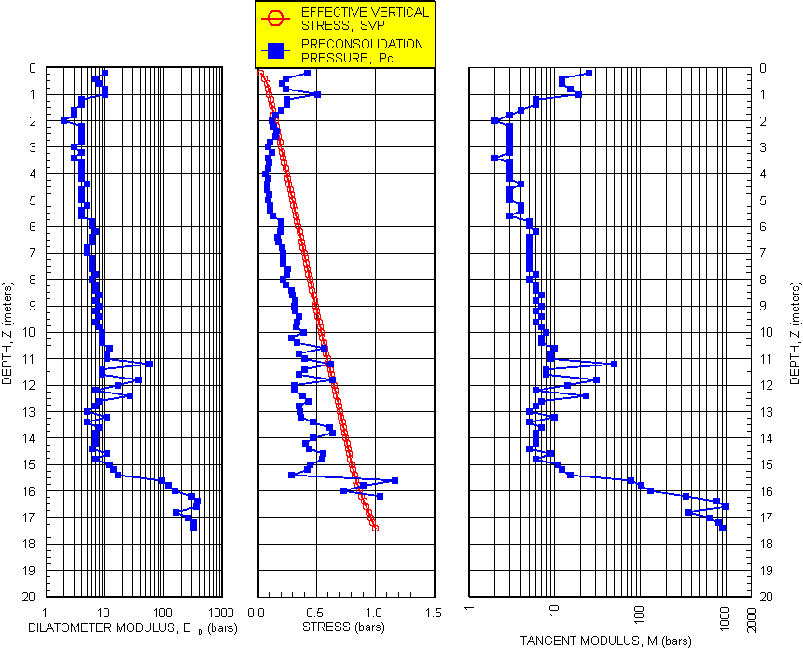
Highly compressible clays
Hoskins Creek Bridge

Slide 50
Project Name | Cost Savings Using DMT
MD Live! | $2,000,000
Towson Circle | $200,000
Retirement Community, Glen Mills, PA | Significant but unknown
Xfinity Live! | $500,000
Obery Court | $200,000
Residences at Rivermarsh | Significant but unknown
Residences at River Place | $80,000

Slide 51
Project Name | Cost Savings Using DMT
Westminister Village | $100,000
Ocean Landing Shopping Center | $750,000
Old Towne Crescent | $150,000
Fox Run Village | $100,000
Monarch Landing | $150,000
1336 H Street, Washington | $80,000

Slide 52
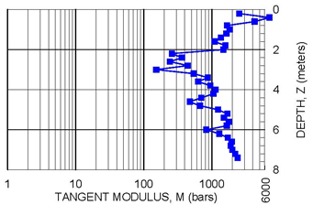
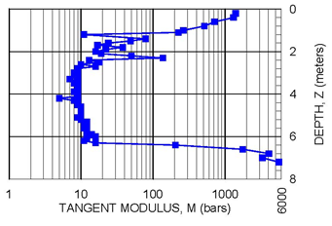
Residences at River Place
Building 1: changed design to
Shallow spread footings instead of piles
Building 2: left design as timber piles

Slide 53
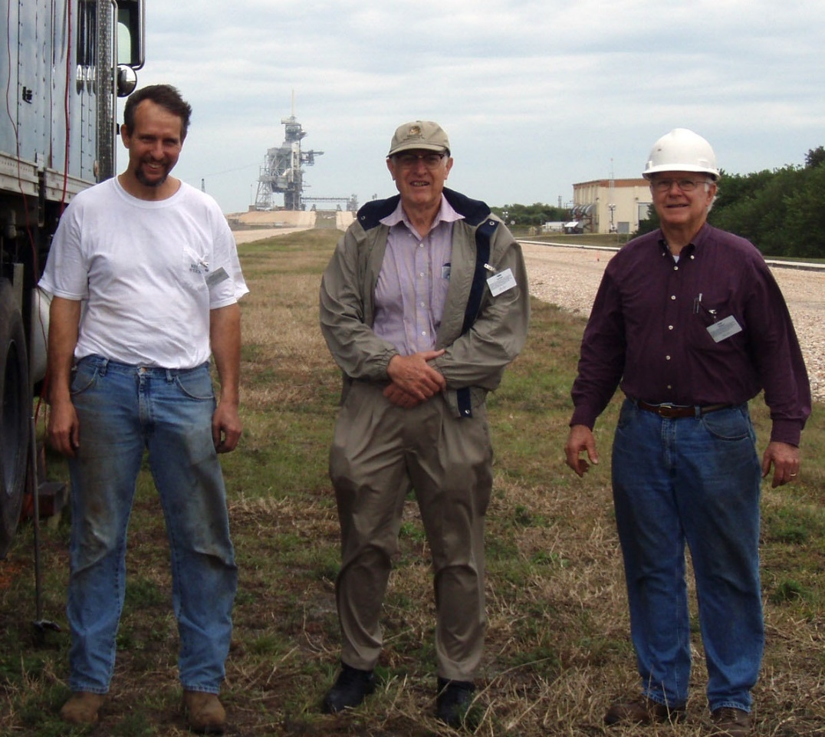
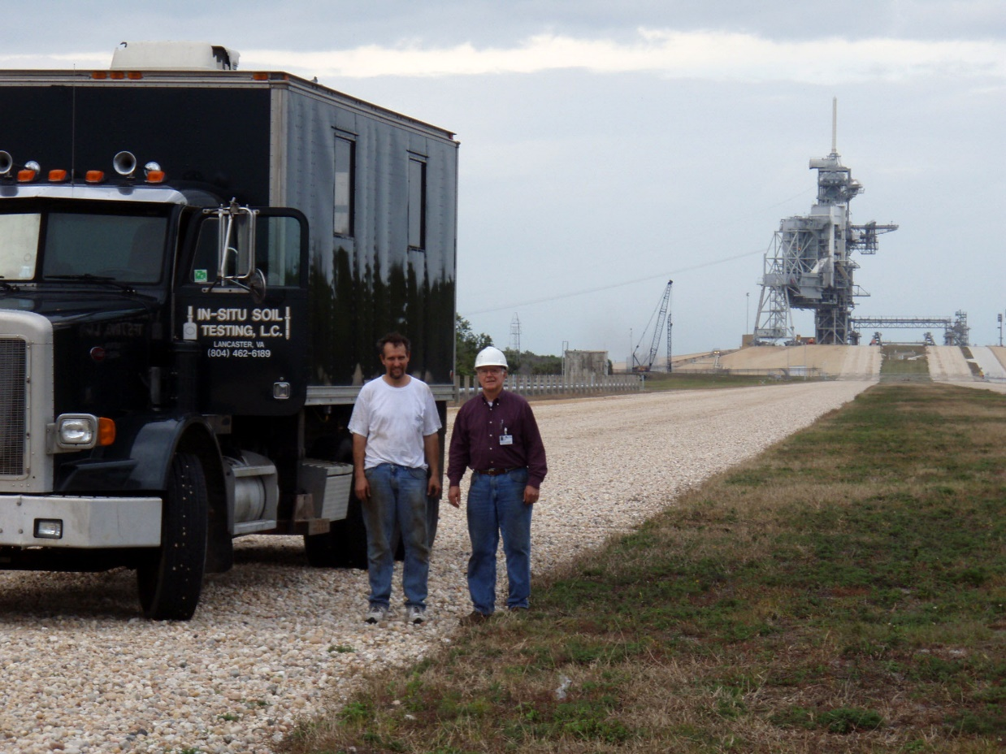
Pushing DMT with Drs. Schmertmann and Crapps at Kennedy Space Center
Used for assessment of crawlerway soils for new space shuttle load of 25,000 kips—highest load

Slide 54
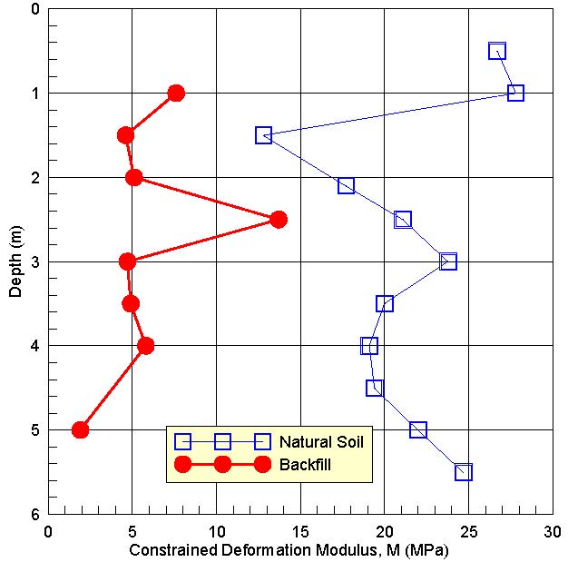
 | Backfill | Natural Soil
Total Unit Weight (pcf) | 118.6 | 111.9
Void Ratio | 0.75 | 0.84
Natural Soil and Backfill had same Gradation
The Importance of Soil Ageing

Slide 55
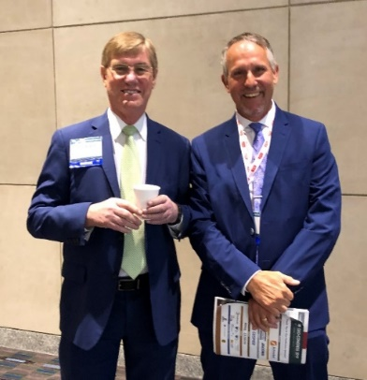
CONCLUSIONS
Use dilatometer tests for predicting settlement of shallow foundations
  Case studies show DMT has lowest coefficient of variation
Engineers should make the measurements because they understand the design needs
Technicians only collect numbers—do not have educational background to understand their meaning or make any field changes
Encourage you to vote for
Dr. Jean-Louis Briaud
for ASCE President this month!

