Slide 1
IN-SITU GONE OVERBOARD AND OTHER INNOVATIONS
Roger A. Failmezger, P.E., F. ASCE, D. GE
Geo-Kansas City Annual Meeting
April 5, 2019

Slide 2
Outline
Performance and Financial Failures
Why we need accurate measurements and design models
Harry Nice Bridge
Route 301 over the Potomac River
Heavy Seafloor Direct Push System—like performing soundings on land
Calvert Cliffs Power Plant
Performing a 400 foot deep Dilatometer Sounding—Deepest ever done
Cyclic Borehole Shear Test
In Development (Dr. Jeramy Ashlock—Iowa State University)
Dynamic Shear Strengths/Residual Shear Strengths

Slide 3
TYPES OF FAILURES
Performance Failure
Outcome has an undesired consequence
Financial Failure
Poor design model and parameter evaluation creates overly costly design because of high uncertainty/lack of knowledge
Settlement Evaluation
Need Static Deformation Test => Dilatometer, Pressuremeter, Lab Consolidation Test
Vertical Pile Capacity
CPT ideal model/PMT for stronger soil/rock
Lateral Pile Capacity
Need Lateral Test—DMT/PMT
Never Want the Test to be Your Source of Uncertainty
Accurate Design Balances Performance and Financial Failures– Select the Appropriate Probability of Success

Slide 4
Probability of Success
Because of uncertainty, design solution is not deterministic, but rather probabilistic solution based on a bell-shaped curve
Bell-shaped curve is defined knowing:
Average Value
Standard Deviation
End Limits
Beta probability distribution curve gives engineer best solution—Choose the end limits
Total area under curve must always equal 1.0
Probability of success is the area under curve in the success zone

Slide 5
Same Soil—Different Tests and Modeling

Slide 6
Lack of Knowledge→More Expensive Design Probability curves shift to the right for same Success

Slide 7
Plot Average Factor of Safety and its Standard Deviation to Determine Probability of Success

Slide 8
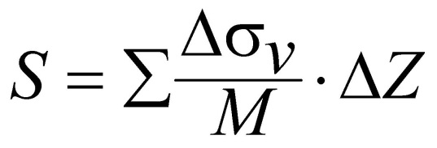
Dilatometer Predicted Settlements
COV = 0.18
{After Schmertmann (1986) and Hayes (1986)}

Slide 9
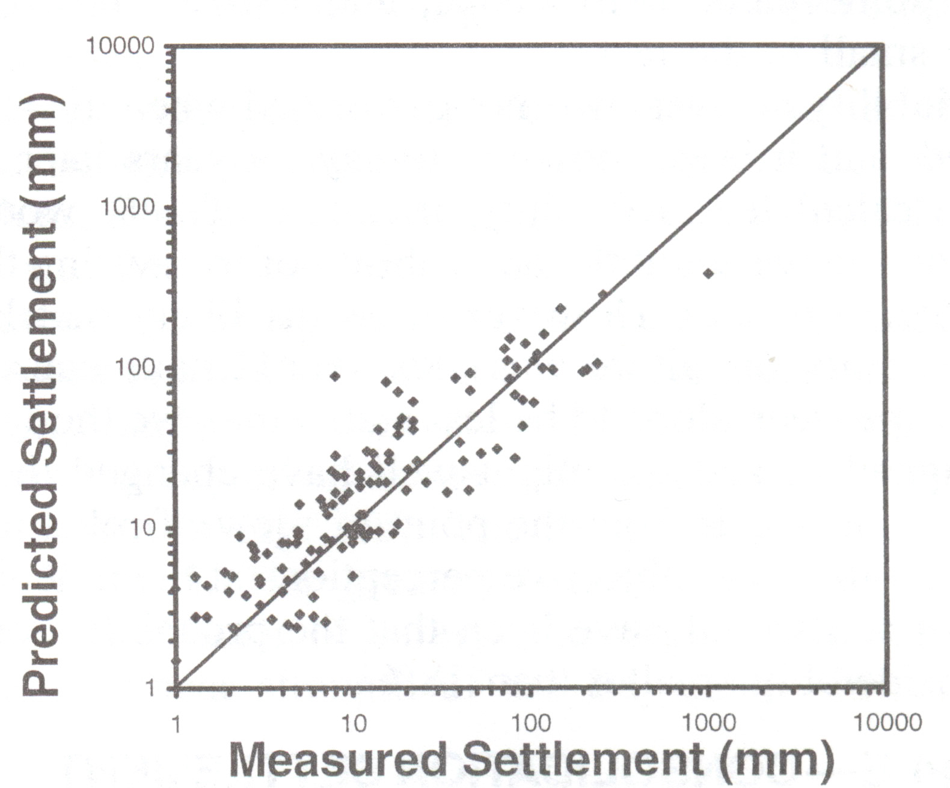
SPT N₆₀
Sands Only
COV = 0.67
Financial Failure Will Certainly Occur!
(After Burland and Burbridge, 1985)

Slide 10
Harry Nice Bridge Subsurface Investigation
Performed CPT, DMT, PMT, VST, SPT and Seismic with True Interval (0.50 m) DMT Module
Discuss what techniques we used to more efficiently perform these tests
Compare the undrained shear strengths and deformation moduli from the tests
Tests were performed in clusters at the north and south ends of the channel

Slide 11
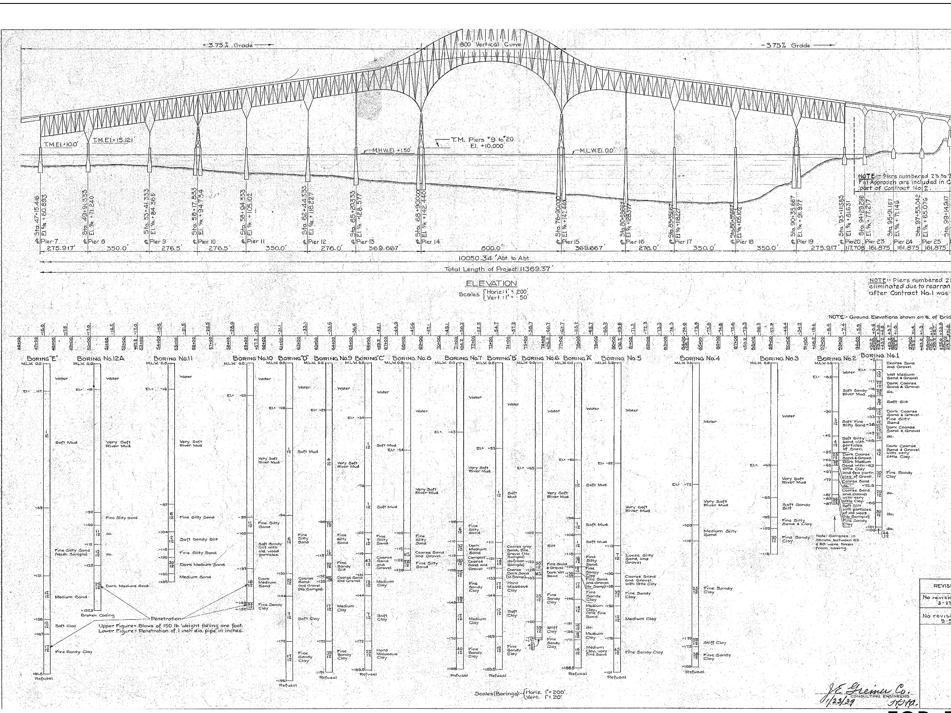
Subsurface Information from 1939

Slide 12
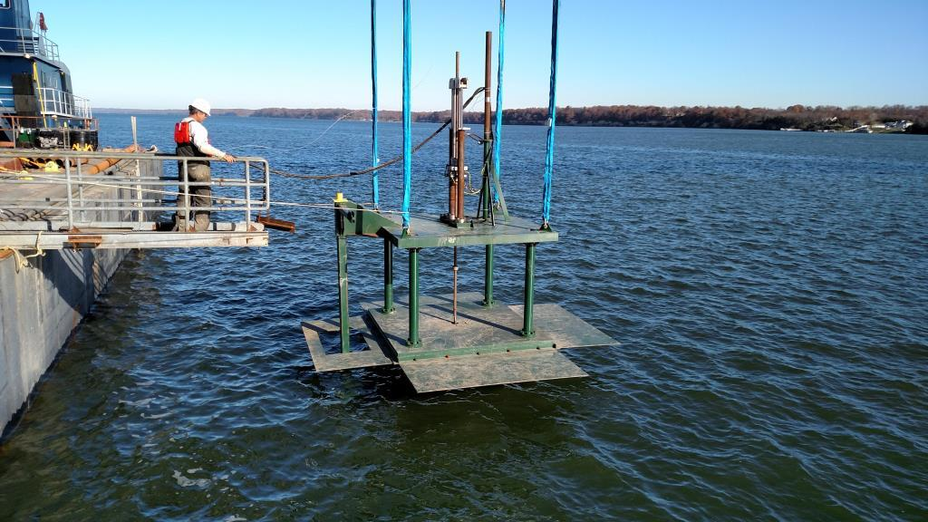
15-Ton Capacity Seafloor Direct Push System
Base Area = 192 sq. ft.

Slide 13
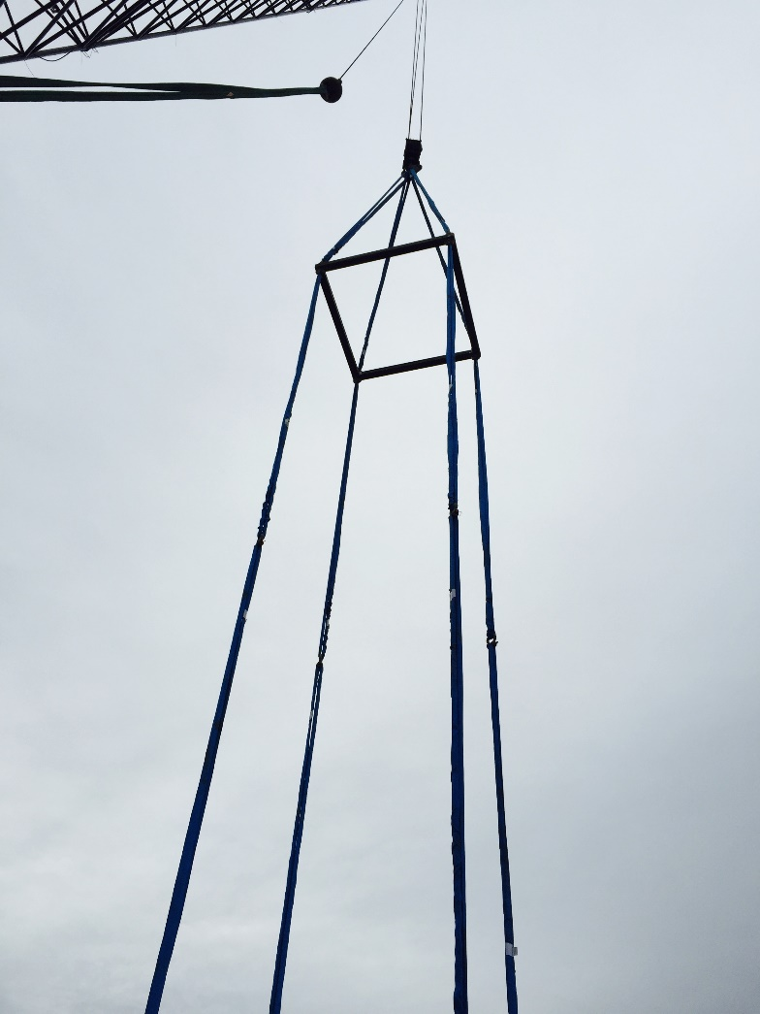
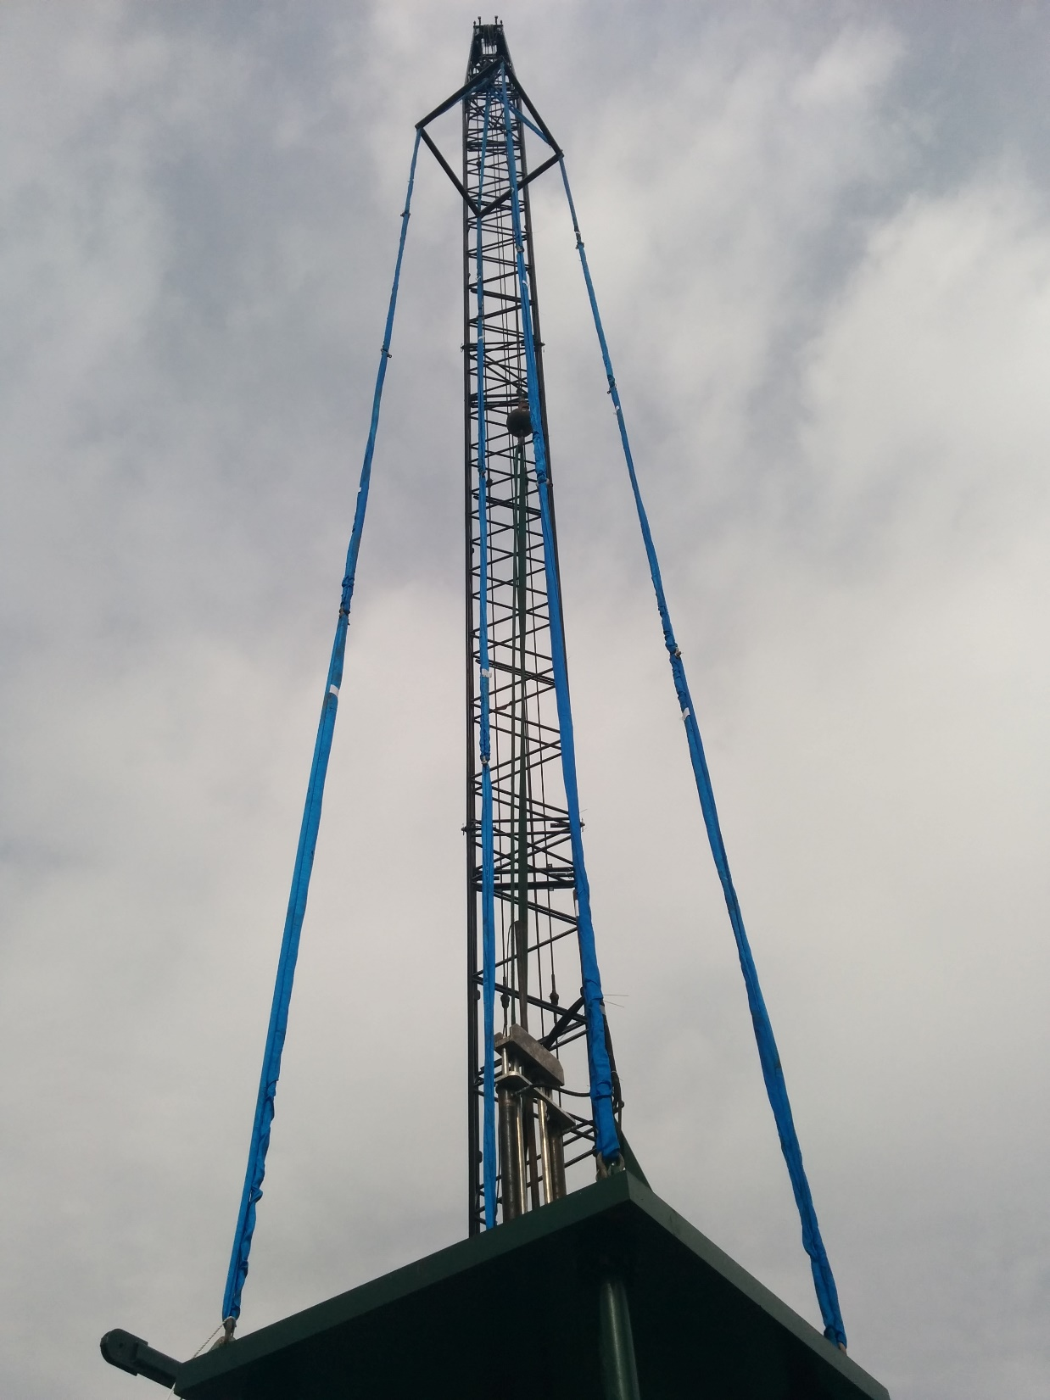
Using Spreader Frame to Keep Slings Vertical

Slide 14
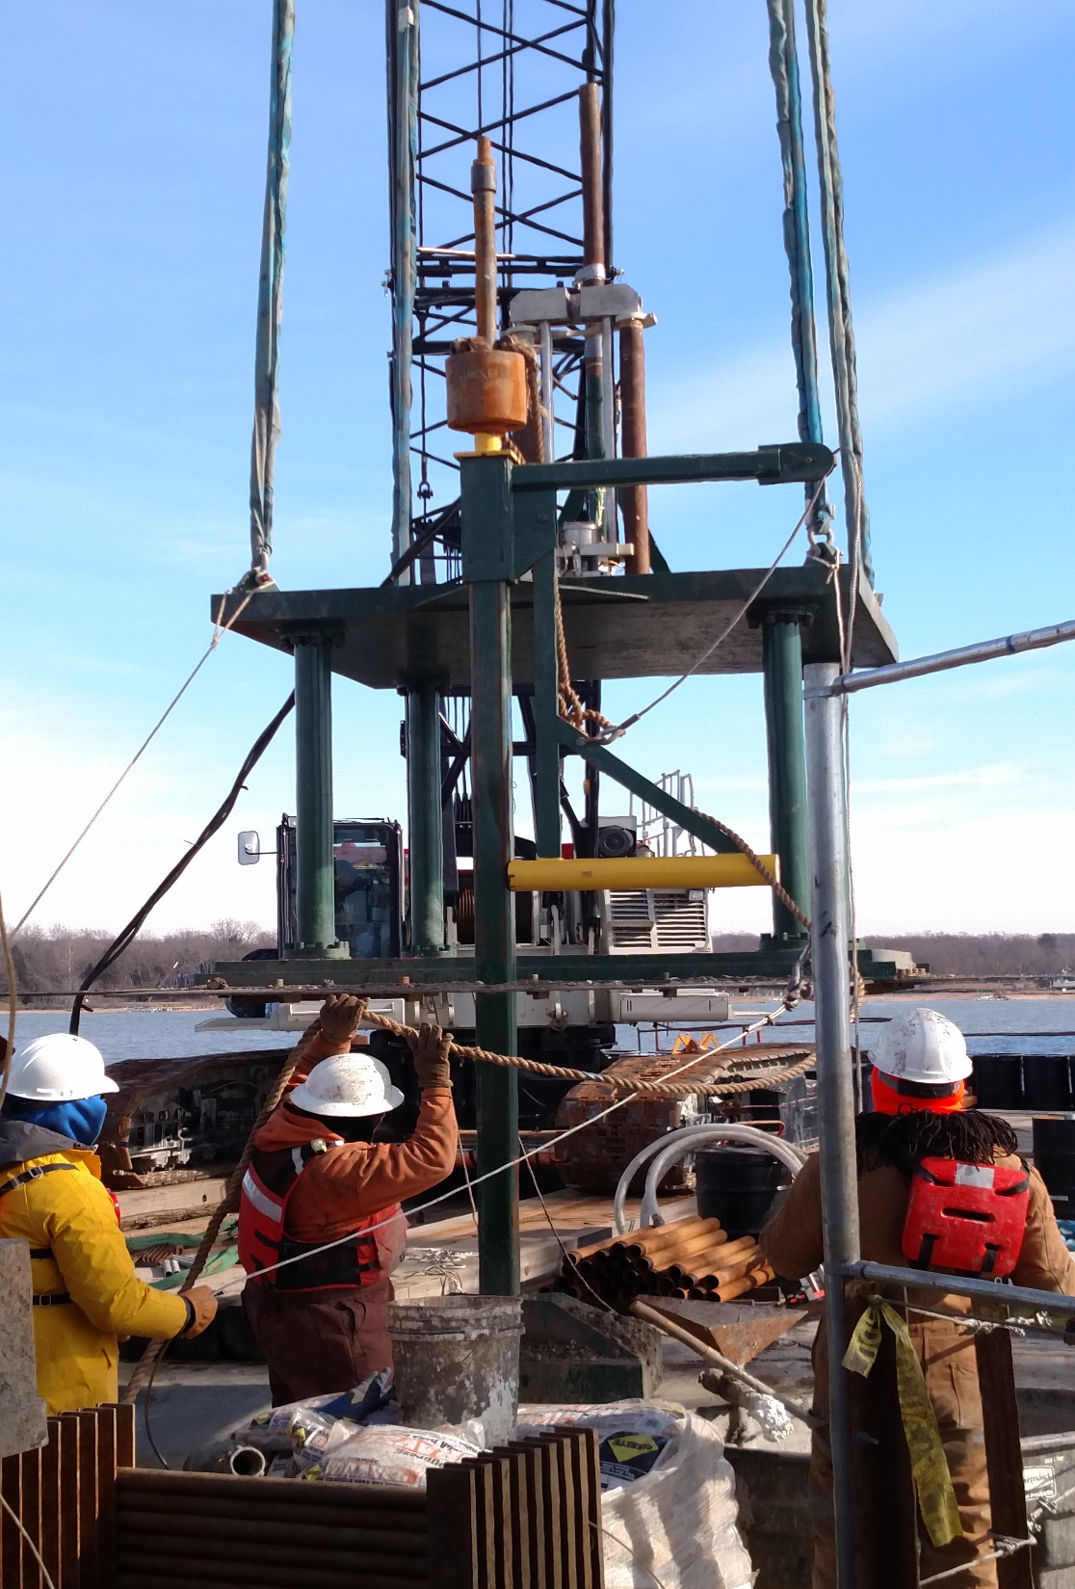
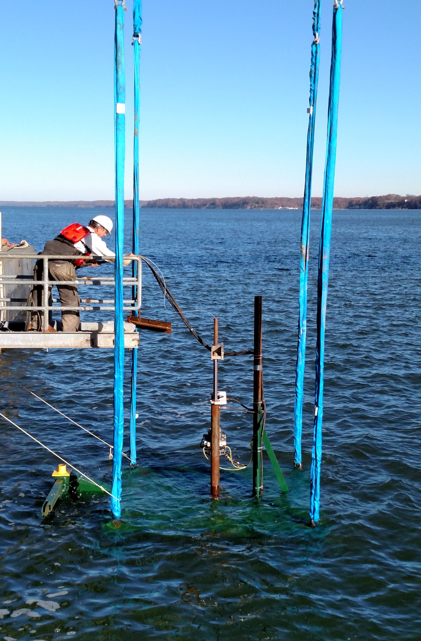
Seismic Hammer
Lowering Direct Push System

Slide 15
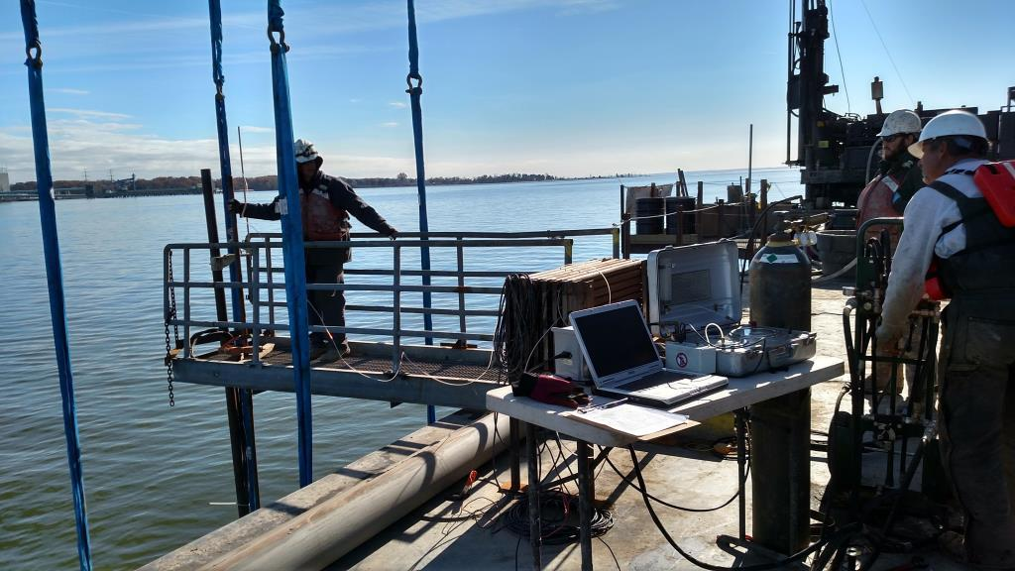
Performing Dilatometer Tests Using Seafloor System

Slide 16
Advantages of Seafloor Direct Push —Like Pushing on land
Testing starts at the mudline
Measure the strength and deformation properties of very soft muds
3-inch casing attached to the top of the seafloor system and extended to the barge deck serves as fixed reference to measure the tests depths
Does not move with either waves or the tide and provides accurate measurements
Attached hydraulic and air hoses, load cell and camera cables to casing
Rod pushing avoids zone between barge deck and mudline of parasitic rod buckling or lateral movement of casing
Probes are pushed at a constant 2 cm/sec rate satisfying ASTM
Waves do not alter this rate or cause pinching of cables

Slide 17
Pressuremeter Tests
Used Texam Unit and performed strain controlled tests
About 40 data measurements/test
Measured pressures with a digital gauge—accurate to 1 kPa
Used 74 mm tri-wing bit for cohesive soil and 76 mm tri-cone bit for cohesionless/cemented soil
High quality borehole critical—experienced drillers important

Slide 19
Vane Shear Tests
Used AP van den Berg I-VANE
Vane Motor at bottom of hole turned vane and measured torque
No parasitic rod friction
Computer at surface reads values from connecting cable and displayed results while performing test
Peak: turned vane 0.1º/sec for ¼ revolution
Rapid turning 6º/sec for 10 revolutions
Remolded: turned vane 0.1º/sec for ¼ revolution

Slide 20
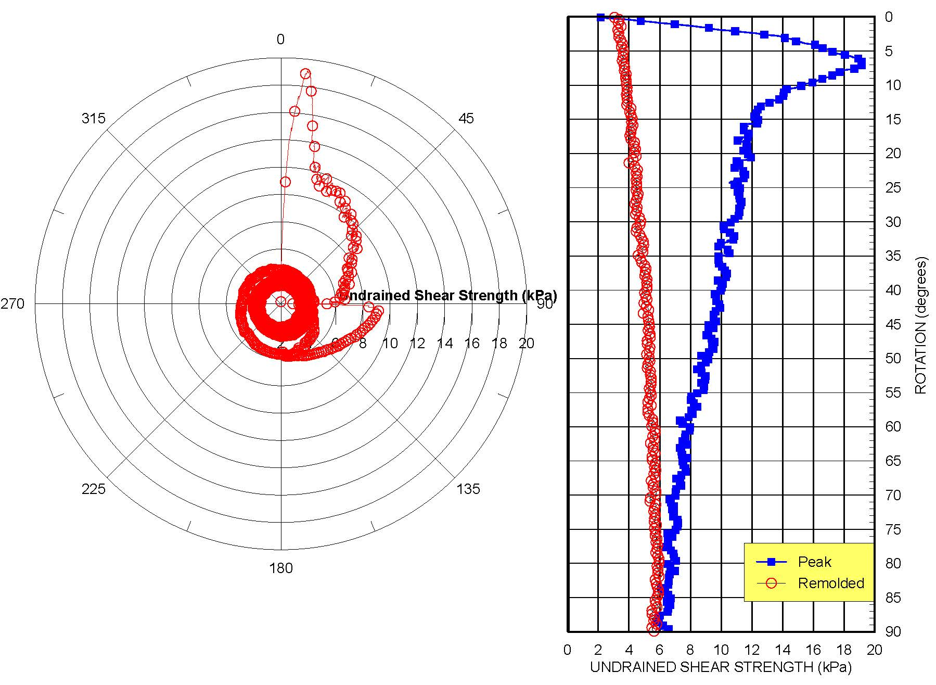

Slide 21
Standard Penetration Tests
Used 125 mm diameter steel casing telescoped inside 200 mm diameter steel casing
Added bentonite and polymers to the river water to make drilling mud—added soda ash to reduce the pH
Used NWJ drill rods (35 mm ID) for good mud circulation
Drill rods and steel casing were quite heavy for drill crew to maneuver
Used crane on barge to either lower or remove them from hole
Drilled lowered front jacks moving drill derrick out of way
Crane could handle 110 feet (34 m) with each of its two hoists
Crane significantly improved efficiency of drilling/sampling operations

Slide 23
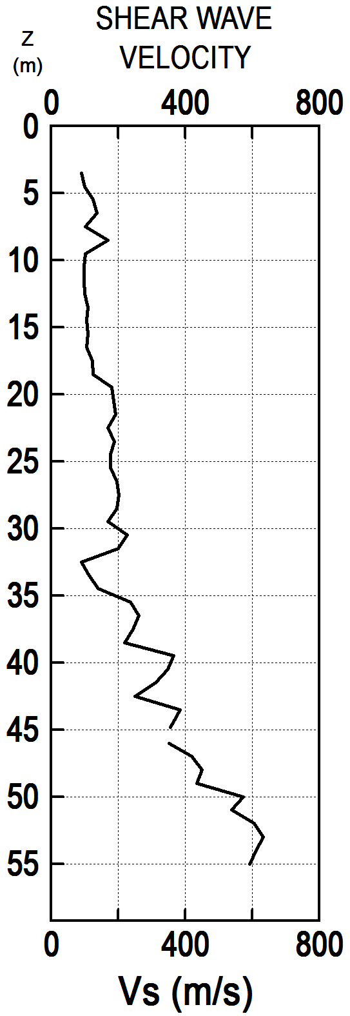
True Interval Seismic Tests
Contract required both compression and shear seismic tests to 55 meters below mudline
Compression waves measured the speed through incompressible water (1500 m/s—wasteful)
Cemented layers prevented penetration from top to bottom
Drilled 125 mm hole to 56 m
Lowered SDMT probe to 55 m carefully aligning sensors
Backfilled with washed fine gravel about 5 m above test
Performed seismic tests (multiple strikes) and then raised probe 1 m for next test
Used large hammer from seafloor to generate waves

Slide 24
North Side
Enlarged scale for upper 15 meters
SOUTH END OF RIVER CHANNEL

Slide 25
SOUTH END OF RIVER CHANNEL

Slide 26
South Side
Enlarged scale for upper 15 meters
NORTH END OF RIVER CHANNEL

Slide 28
Bridge Conclusions
Seafloor direct push system efficiently pushed DMT and CPT—like performing them on land—the way to go!
Successfully measured seismic waves with true-interval seismic DMT probe and seafloor hammer to 58 meters below mudline
Undrained shear strength and deformation modulus values compared favorably with DMT, PMT, VST and CPT with properly chosen correlation factors
Adjust the investigation as data are collected
1939 data—inadequate—show sandstone instead of cemented sand layers
Upper clays much softer than thought
Lower soil much stiffer and stronger than thought—needed more pressuremeter tests
Ideally, investigations could include direct push sounding and soil boring adjacent to each other and performed simultaneously
If direct push sounding has penetration refusal before desired depth, perform pressuremeter tests in boring to get high quality data in that missing in-situ test zone
Best use of costly barge time

Slide 29
Lessons Learned
Job has much stress because of high barge costs
Work with people that you like
Get the best and most experienced drillers and engineers
Modifying Seafloor System
Using 10 foot long N-rods—structural section modulus 2.3 times large CPT rods—push with much more thrust without buckling risk
While heavier only 1/3 number of joints
Seismic hammer with hydraulic trip lift
Compression or P waves waste of time
Build a 16 foot by 16 foot structural frame with fold down decking on side of barge for safer working platform
Lower Seafloor system through this framed hole—minimizes crane reach
Drug and alcohol testing for barge crews
Crane operator caught at end of job smoking marijuana

Slide 30
Performing a 400-foot deep Seismic Dilatometer Sounding

Slide 31
DMT Project Requirements
Perform DMT at 1 foot depth intervals to 400 feet
We convinced the client to perform tests at 20-cm intervals (5 tests per rod) because it would not take much more time to do so and 50% more information would be acquired
Perform true-interval seismic tests at 1-m depth intervals until shear wave attenuated
Perform pore pressure dissipation tests
Obtain “C” readings below the water table

Slide 32
Direct Push Method
Impossible to successfully perform to full depth
Cemented sand layers would cause penetration refusal
Sounding would be too inclined from vertical
Would develop high rod friction

Slide 33
DMT Torpedo

Slide 34
DMT Torpedo Method (cont.)
DMT cable was threaded through the AW rod and then exited to outside of the rods
Rubber washers around rods to give lateral support
Used an adapter to NWJ rods
GeoServices lowered the DMT torpedo and NWJ rods to the bottom of the hole
Used 20 foot sections of NWJ rods and a 5-foot long NWJ rod with welded 5/8 square stock (centralizer rod) between the 20-foot sections
DMT cable was taped to the outside of the NWJ rods at 10-foot intervals
At the top of the NWJ rods, an adapter was used to channel the cable back into AW rods

Slide 35
Centralizer

Slide 36
DMT Torpedo Method (cont.)
GeoServices moved their CME-75 drill rig off of the hole
Moved In-Situ track rig back exactly over the hole
Camera was placed inside the hole in the track rig
Monitor with a cross-hairs was watched as track rig was repositioned over the hole

Slide 37
DMT Torpedo Method (cont.)
AW rods had the same diameter as the In-Situ direct push rods
Existing In-situ clamp worked with the AW rods
Threaded DMT cable through the AW rods
Lowered BX-casing (3-inch OD) over AW rods to provide lateral support
Pushed DMT to test depths (20-cm intervals) and performed test

Slide 38
In-Situ Direct Push Clamp

Slide 39
DMT Control Unit and Auxiliary 100 Bar Gauge
Some pressure readings were higher than the standard 60 bar gauge—added a 100 bar gauge

Slide 40
Drilling Equipment
Selecting the drill rig with the necessary accessories was critical to successful project
High capacity Gardner –Denver piston pump
3 different speed/capacity winches
Hydraulic Break-out Wrench/Rod Clamp
Footing
Extensive maintenance was performed on drill rig including rebuilding of pumps prior to mobilization

Slide 41
GeoServices CME-75 Drill Rig

Slide 42
Additional Drilling Efficiencies
Used a three person crew that had combined 70 years of experience
Used a large mud pit lined with plastic
Circulated the drilling mud through a desander to keep mud clean
Used steel saw horses to hold their NWJ rods in 20-foot sections

Slide 43
Mud Pit

Slide 44
NWJ Rods Kept on Steel Saw Horses

Slide 45
Additional Drilling Efficiencies (cont.)
Used 4 hoisting plugs so that they could simply clip the winch line on rod and were never waiting for the rod to be hoisted
Used three winch cables
100 feet of rod could be hoisted with light duty but fast winch
100 to 200 feet of rod could be hoisted with the medium duty winch
200 to 400 feet of rod had to be hoisted with the heavy duty but slower winch

Slide 46
Additional Drilling Efficiencies (cont.)
GeoServices’ driller, Ronald Stidham, knew which winch to use when
At 400 feet, the GeoServices’ crew was able to trip either in or out of the hole in about 45 minutes
Used a reel to keep DMT cable from getting tangled

Slide 47
DMT Cable Reel

Slide 48
Satisfying Conclusions
Significant planning for a complicated project made the project go smoothly in the field
Selecting the most suitable equipment enabled the project to be successfully completed
Working with an experienced driller and crew eliminated many field frustrations

Slide 49
Cyclic Borehole Shear Test (CBST)
Soil Testing Device

Slide 50
The Problem
“Virtually every structure is supported by soil or rock. Those that are not either fly, float, or fall over.” –Richard L. Handy
Soil shear strength parameters (friction angle φ’ and cohesion c’) are required for nearly ALL foundation design and slope stability problems
Shear strength parameters are typically obtained by
Laboratory tests: time-consuming, results affected by sample disturbance
Indirect empirical correlations to penetration test (SPT, CPT) indices: imprecise, not a direct measurement of shear strength
Other in-situ tests, most of which measure a test index value, do not directly measure shear strength
Soil liquefaction susceptibility is also assessed using time-consuming lab tests, or in situ SPT, CPT, or shear wave velocity tests. None of these in situ tests actually simulate in situ the cyclic stresses and buildup of pore pressures that cause liquefaction.

Slide 51
The Solution
In Situ Cyclic Borehole Shear Test (CBST) Device
Applies controlled normal and shear stresses to soil through serrated plates in contact with borehole wall, which create soil-on-soil failure surfaces
Applied shear stress can be monotonic or cyclic
Can measure pore water pressure in soil during tests
Monotonic test gives soil shear strength parameters
(friction angle φ’ and cohesion c’)
Cyclic test reveals soil behavior under repeated loading such as beneath bridge foundations or during earthquakes, can be useful for measuring residual shear strength parameters, cyclic behavior, and assessing liquefaction susceptibility

Slide 52
In Pictures
Pressure Tubing and Pneumatic Cylinders: for pneumatic control of expansion of shear and anchor heads, and vertical actuation of cyclic shear head.
Expanding Anchor Head: expands against inside of hollow-stem auger, borehole wall, or borehole casing to provide reaction for pushing/pulling cyclic shear head below.
Load cells and displacement transducers: provide feedback for device control and data for analyzing soil response. Also enable additional test possibilities such as creep and consolidation.
Pressure transducer: measures soil pore water pressure during
testing.
Cyclic Shear Head: (1) expands horizontally to apply user-specified value of normal stress in soil, (2) moves vertically under selectable displacement- or stress-control to apply monotonic or cyclic shear stress in soil. Measuring peak shear stress for a range of normal stresses gives Mohr-Coulomb failure envelope of soil (φ’ and c’).

Slide 53
Deliverables
CBST Device with Control Hardware and Software
One prototype anchored shear head has been built, but software control program and electronic instrumentation/control system do not exist
Development of software control program in LabVIEW
is most difficult task
Validation test results and comparisons to existing test methods
Simpler shear head of traditional BST device sold worldwide by HGI (for comparison only)
Automated non-cyclic BST device showing the type of electronics and software control program that need development
Prototype shear head component of CBST

Slide 54
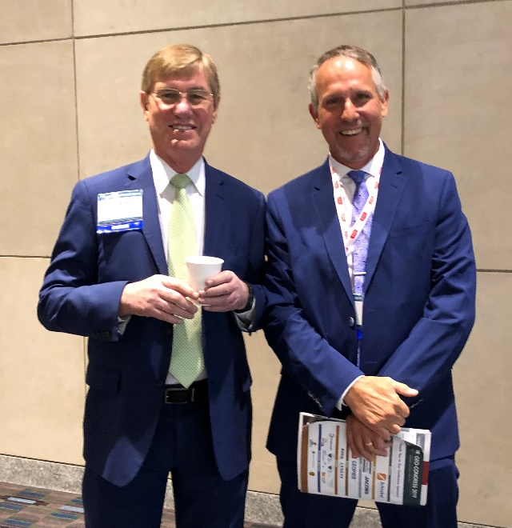
CONCLUSIONS
Choose the tests that best model the design needs
Review case studies to evaluate accuracy of methods
Engineers should make the measurements because they understand the design needs
Technicians only collect numbers—do not have educational background to understand their meaning or make any field changes
Encourage you to vote for Dr. Jean-Louis Briaud
for ASCE President in May!

