Slide 1
Better geotechnical design using dilatometer test data
Roger A. Failmezger, P.E., F. ASCE, D. GE
New Zealand Geotechnical Society
Christchurch, New Zealand
September 13, 2016

Slide 2
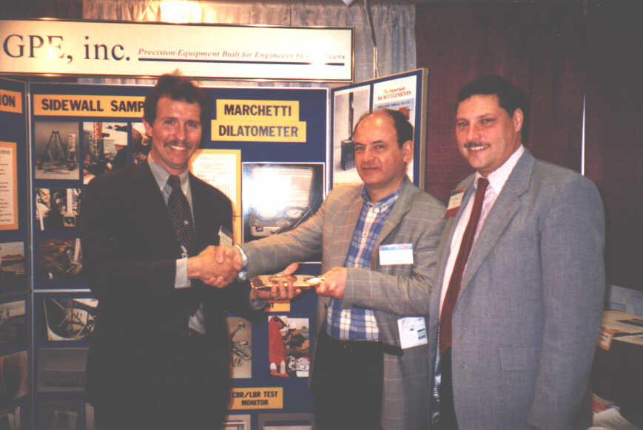
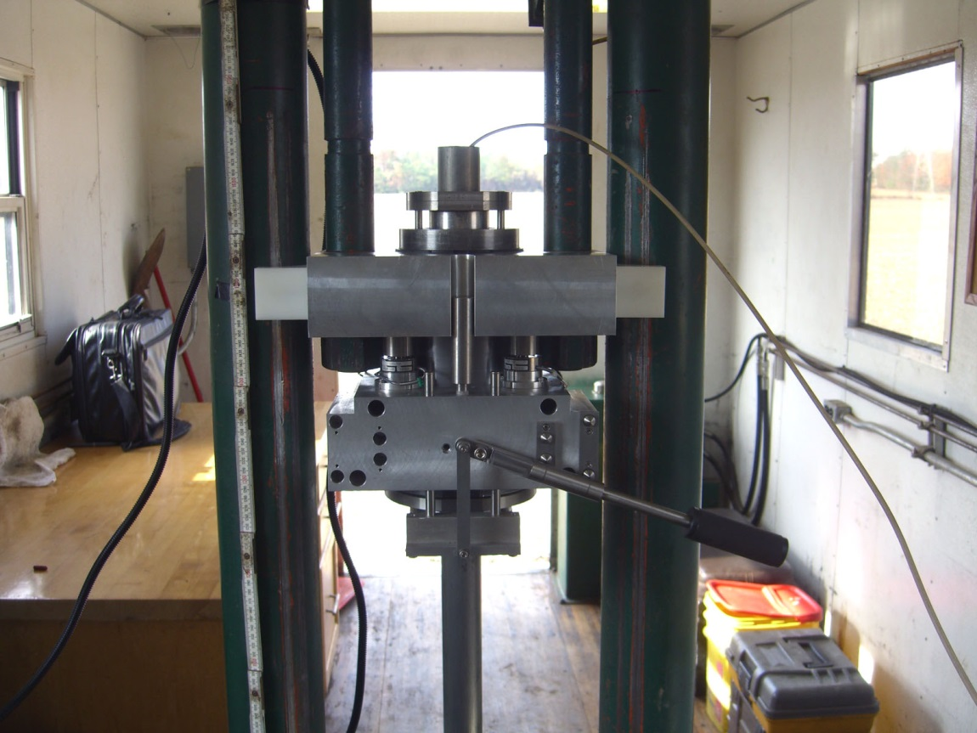
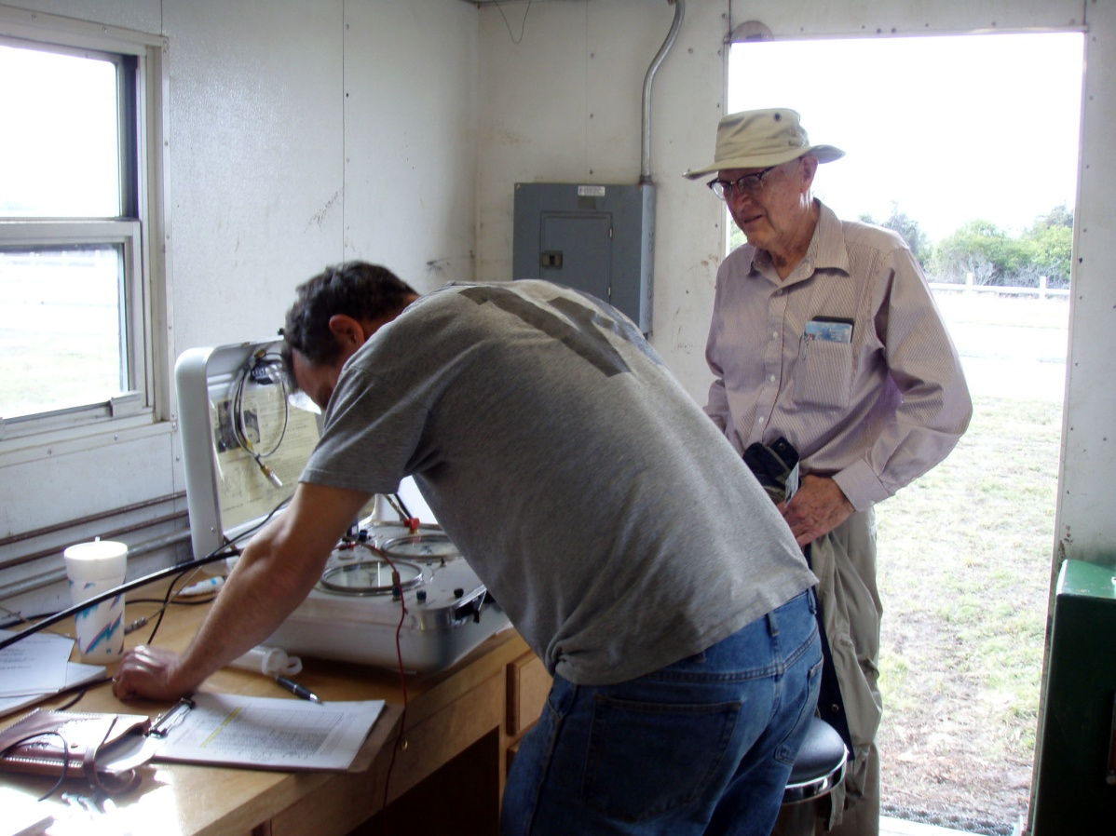
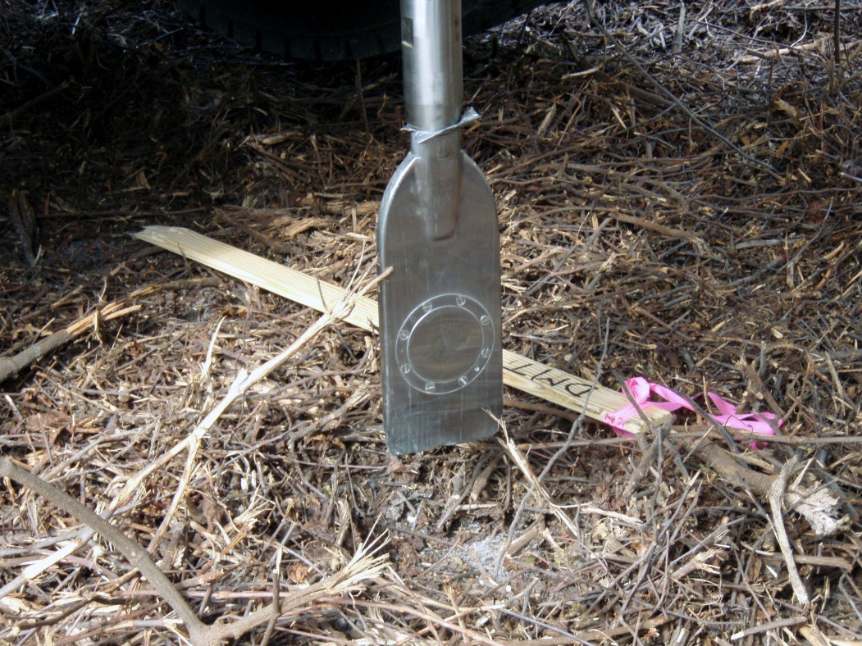
ISC#1—Atlanta 1998

Slide 3
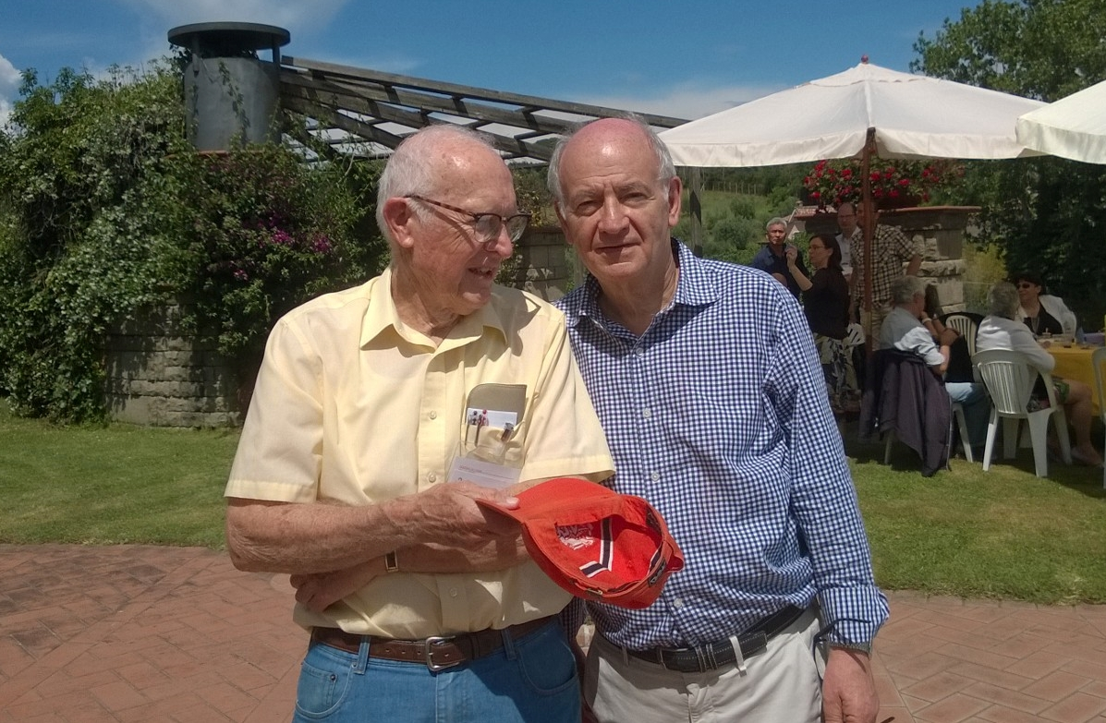
Drs. John Schmertmann and Silvano Marchetti at DMT’15

Slide 4
Reducing Uncertainty/Risk
Because of uncertainty, solution is a curve not a fixed point
For civil engineering applications, probability distribution curves tend to be “bell” shaped
The total area under the probability distribution curve must equal exactly 1.0—100% chance that the event will occur.
Probability of success + probability of failure = 1.0
Use term “probability of success” with owner
Both cases have same probability of success: 95%
High uncertainty costs the owner more money
The primary source for uncertainty should be the soil not the test
Select the in-situ test and design method to minimize uncertainty and make accurate predictions

Slide 5
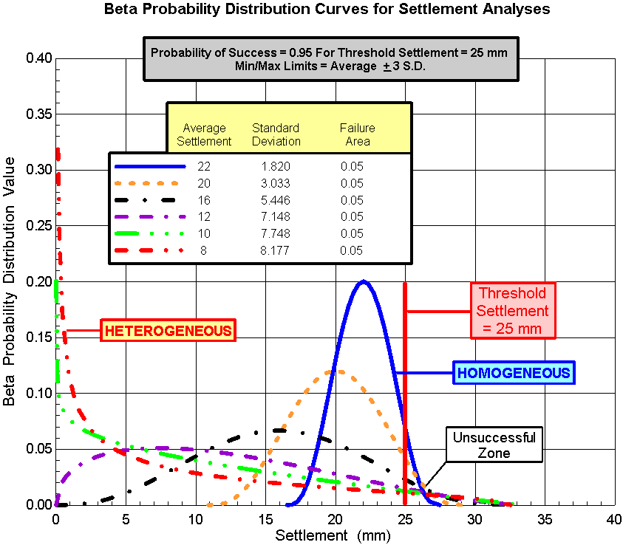
DMT
CPT
SPT

Slide 6
Dilatometer Test
Calibrated static deformation test
Performed at 0.1 to 0.2m intervals (near-continuous)
-Soil Profiling and Data Trending
Low volumetric and shear strain induced during penetration—measures significance of lateral stress and stress history
Accurately measures deformation modulus, drained friction angle in sands (Schmertmann method with thrust) and undrained shear strength in clays [Marchetti or Lutenegger S_{u} = (P₀-P₂)/2.65]
Test Repeatability Error: <10%
Easy to use from drill rig, barge, row boat—but most efficient w/ direct push rig

Slide 7
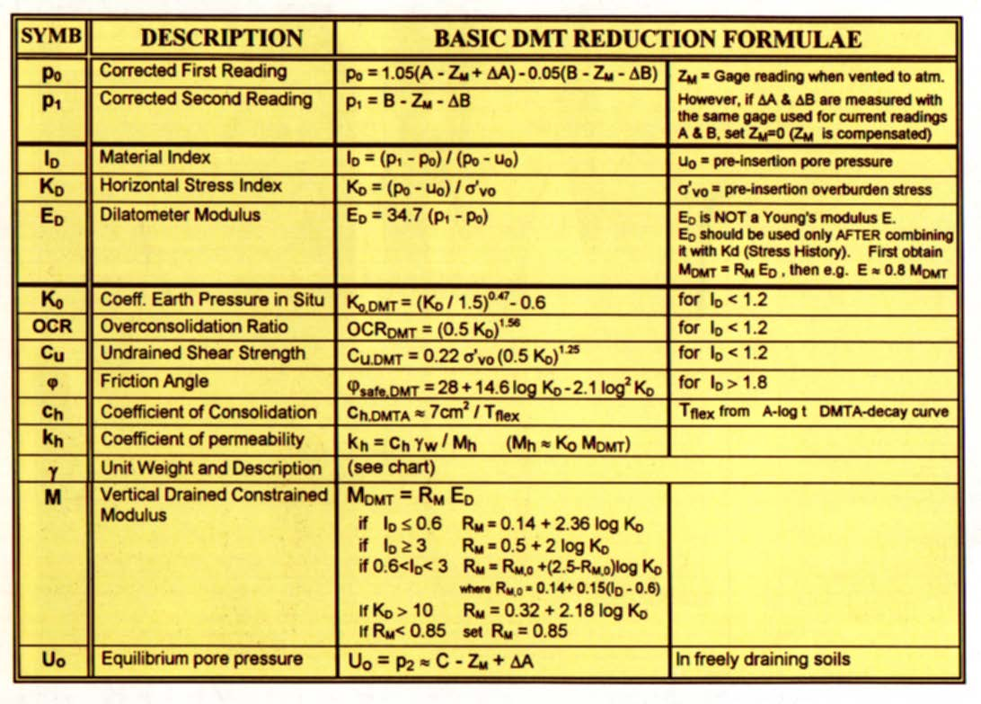
Silvano did excellent research—insignificant changes to his 1980 correlations--a tribute of his contribution to us

Slide 8
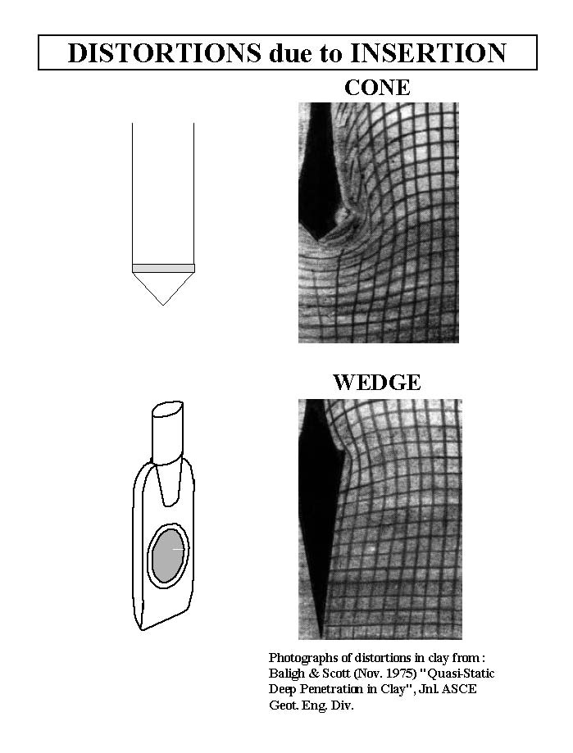

Slide 9
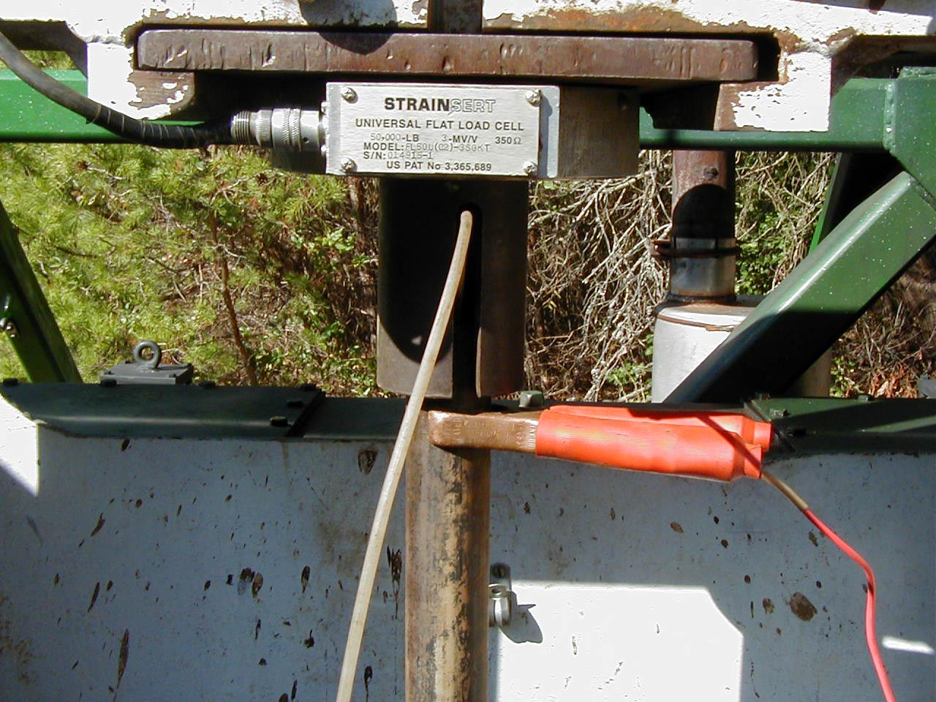
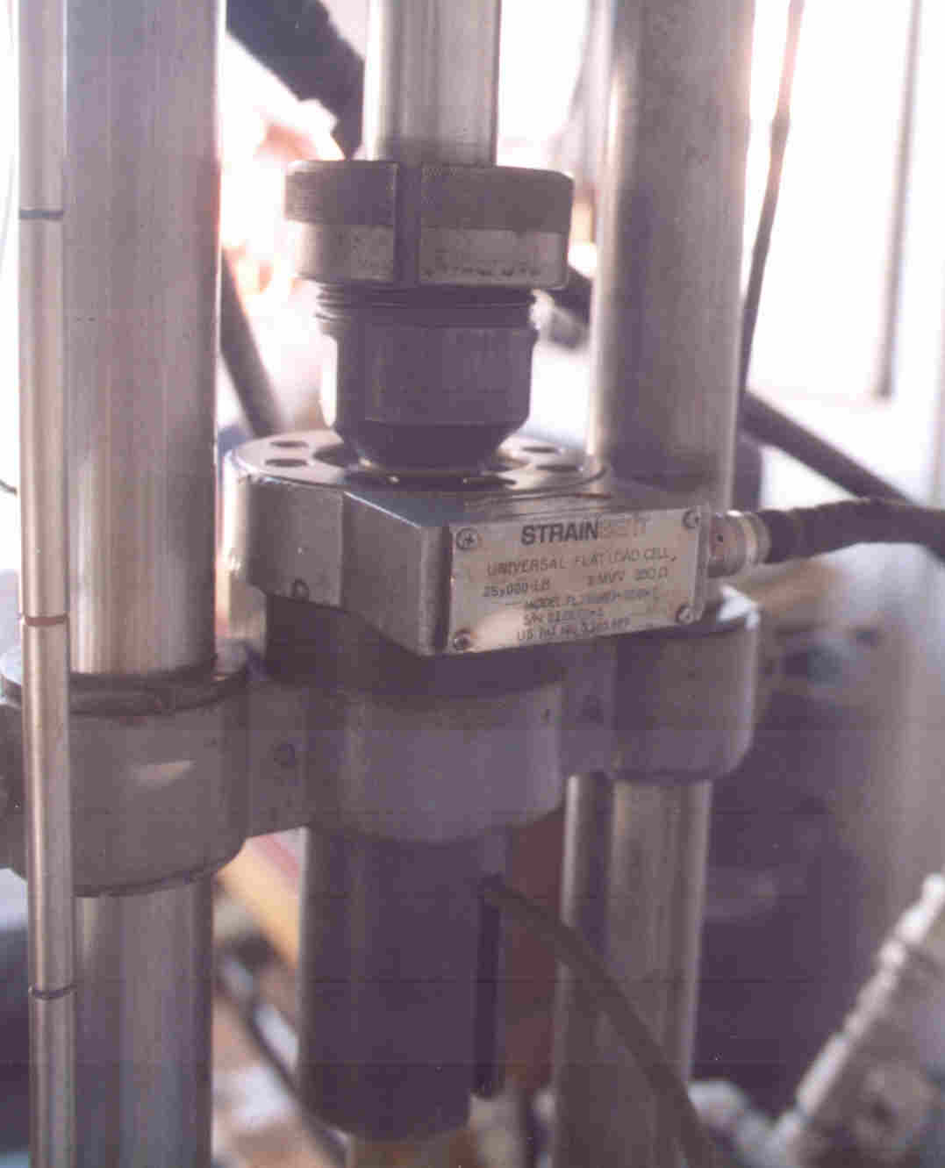
Using a Load Cell to measure thrust
Recommend pushing and not driving DMT
Thrust needed for Schmertmann’s angle of internal friction calculation
q_{d} closely compares to q_{c}

Slide 10
1
2
3
1) Push Dilatometer
blade to test depth
(typ. 20 cm intervals)
at 2 cm/sec and
measure thrust
with load cell
3) Continue to inflate membrane until it moves 1.1 mm. Electrical switch will turn on and record pressure (“B” reading)
2) Soil presses against membrane creating electrical contact--inflate membrane until it separates from
blade and record pressure (“A” reading)
(After Marchetti, 1996)

Slide 11
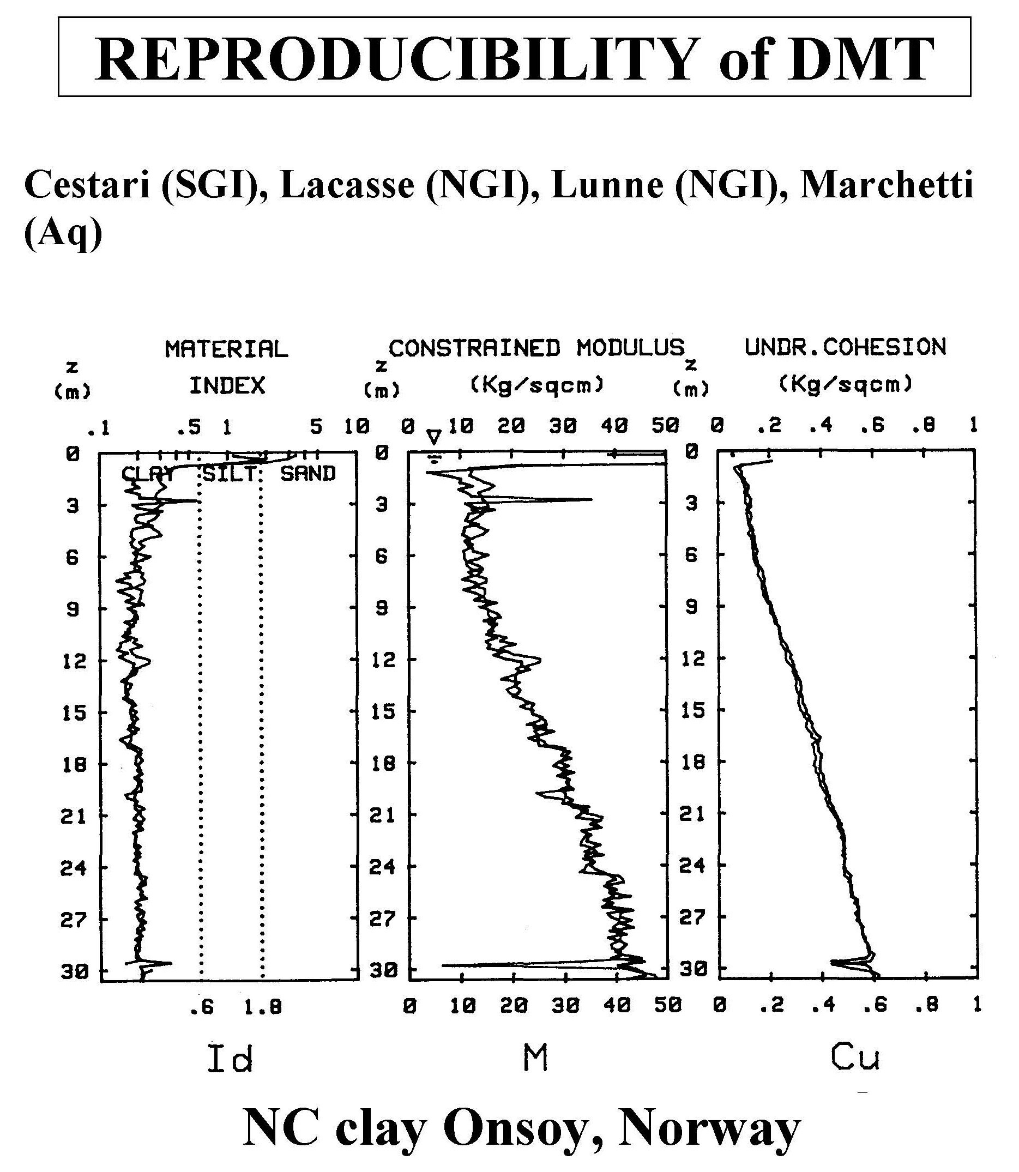
(After Marchetti, 1996)

Slide 12
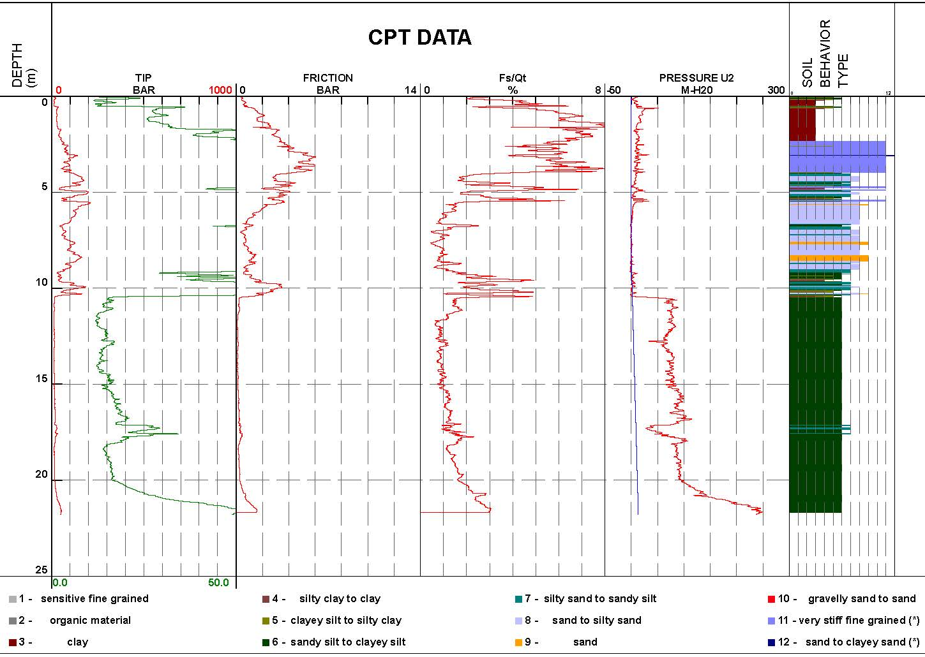

Slide 13
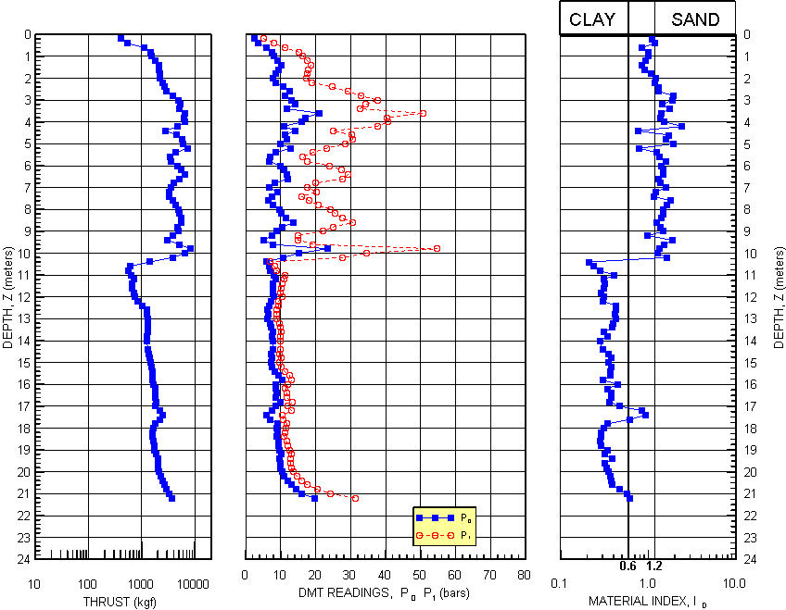

Slide 14
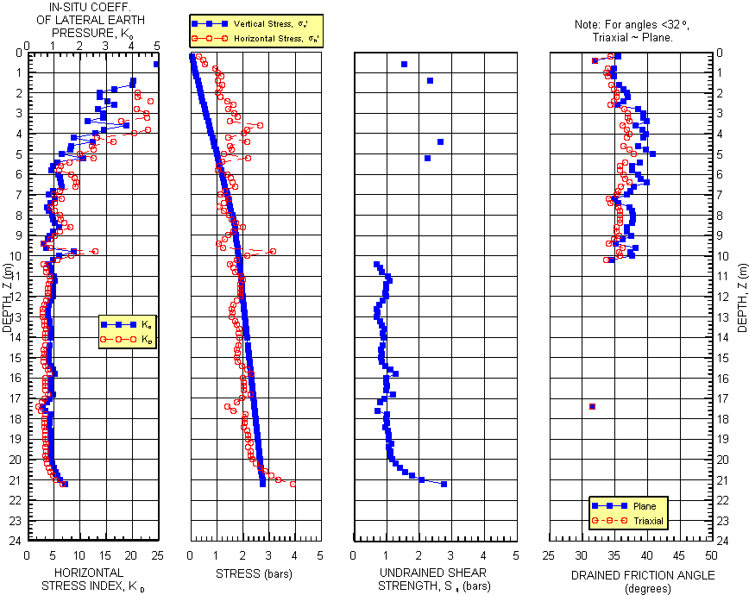

Slide 15
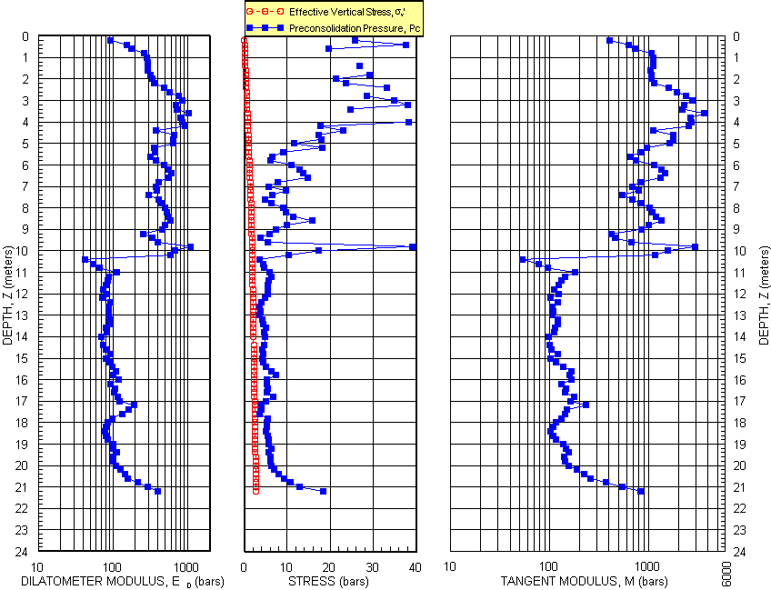

Slide 16
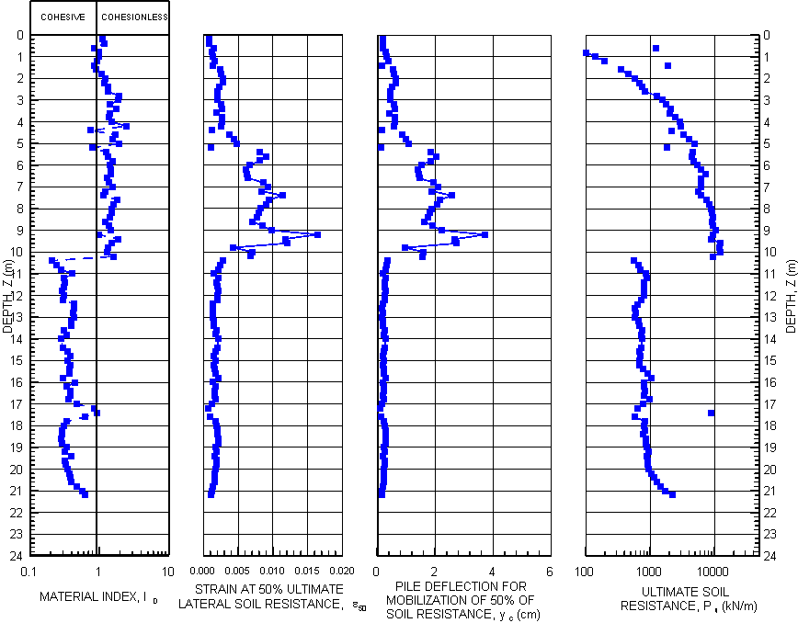

Slide 22
Best uses for DMT data
Predicting settlement/measuring deformation properties
Evaluating slope stability/measuring undrained shear strength for cohesive soil and drained shear strength for cohesionless soil
Evaluating lateral load capacity of deep foundation/determining P-y parameters

Slide 23
shallow foundation design
Engineers have the professional duty to make sure that shallow spread footings will not adequately support the proposed structure before recommending more expensive deep foundations
Must measure the deformation properties of the bearing soil to predict their settlement under proposed loads
-> Dilatometer test – best choice

Slide 24
Standard Penetration Test
Predicting modulus from N-value has wide range of correlation factors
1) the energy not being measured
2) dynamically penetrating the soil
3) the soil being strained to failure
4) remolding of the soil
Best case for SPT:
Using N₆₀ values in sand
Coeff. Of Var. =0.67 – quite high
For 95% certainty sett less than 25 mm,
then ave sett =7.5 mm

Slide 25
Cone Penetration Test
Wide scatter of α factor to obtain deformation modulus from tip resistance
1) straining the soil to failure
2) remolding the soil
3) stress history unknown
Need site specific correlation values to get modulus

Slide 26
Pressuremeter Test
Advantages:
Static deformation test
Empirical design method based on large database of case studies
Can test dense/hard soils when load are high
Slotted casing for gravel formations
Disadvantages:
Test takes 1+ hours to perform
Vertical spacing 1+ m
Can miss thin soft layers

Slide 27
Lab Consolidation Test
Advantages:
With high quality sample can measure the deformation properties
Disadvantages:
Too costly and time consuming to perform numerous tests
Difficult to test cohesionless soil

Slide 28
Dilatometer Test
Advantages:
Economical to perform numerous tests at close intervals
Strains soil to intermediate levels similar to the structure
Measures the effect of soil stress history
Computation error when one uses an average M value for a layer—make layers same thickness as test interval

Slide 29
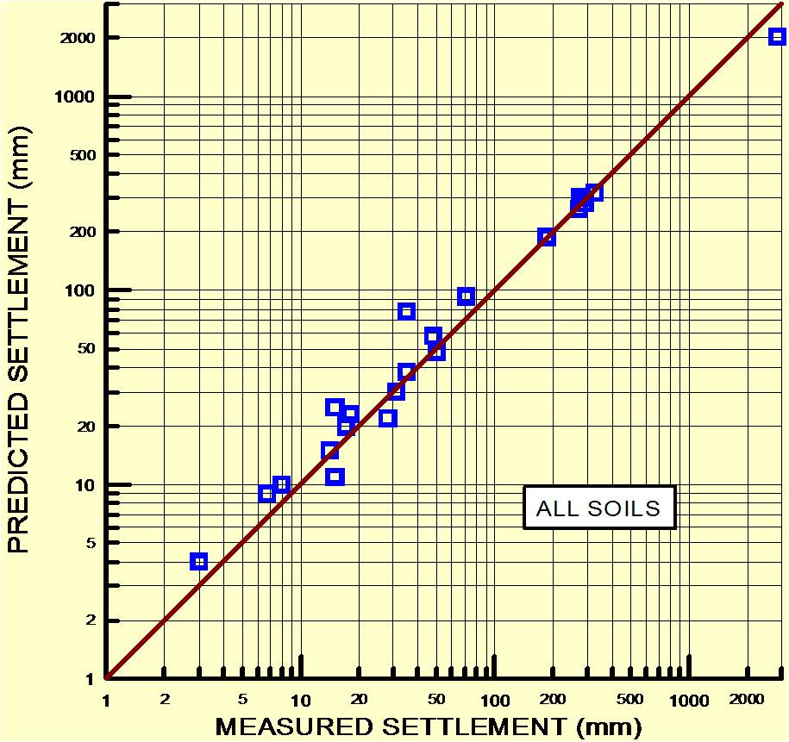
Coeff. Of Var. = 0.18
Quick clayey silt
Niche silt?
Schmertmann, 1986 and Hayes, 1986

Slide 30
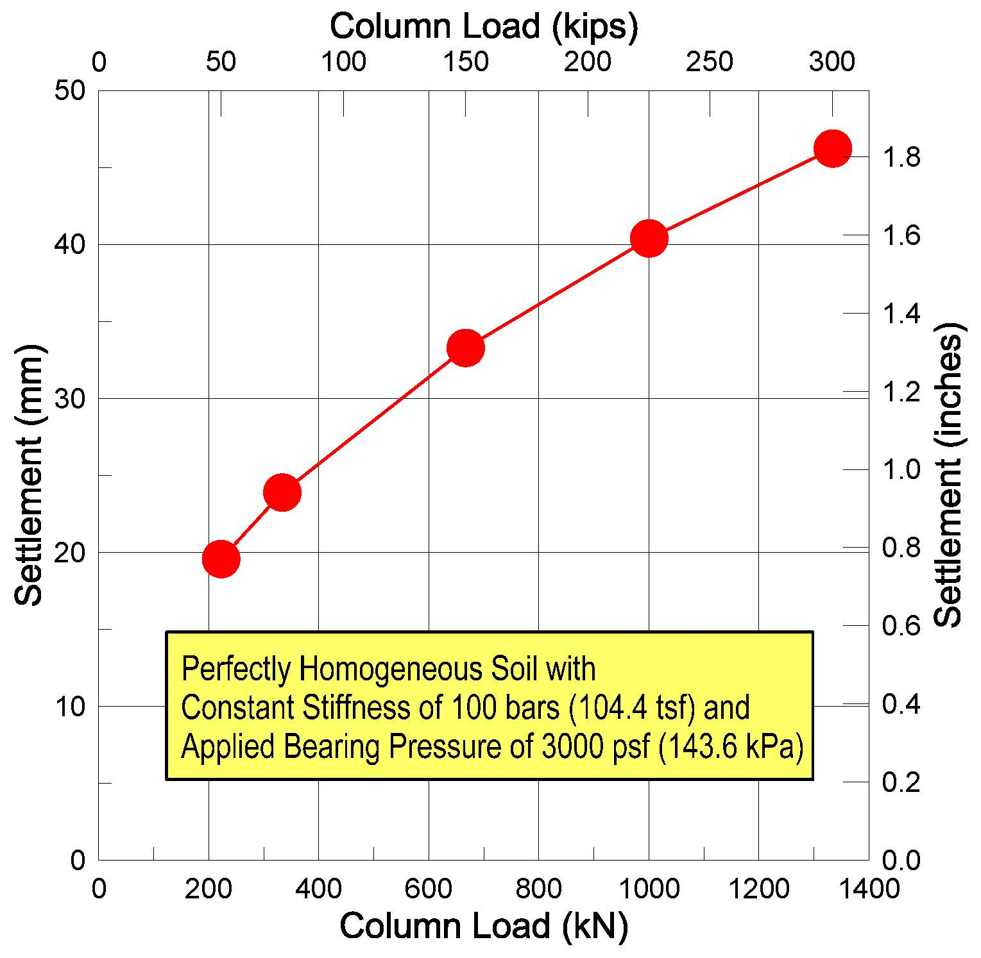
Often Engineers incorrectly recommend one allowable bearing pressure for entire site

Slide 31
Project Name | Cost Savings Using DMT
MD Live! | $2,000,000
Towson Circle | $200,000
Retirement Community, Glen Mills, PA | Significant but unknown
Xfinity Live! | $500,000
Obery Court | $200,000
Residences at Rivermarsh | Significant but unknown
Residences at River Place | $80,000

Slide 32
Residences at River Place
Building 1: changed design to
Shallow spread footings instead of piles
Building 2: left design as timber piles

Slide 33
Four good cases studies where DMT was good choice
400 foot (122 meter) deep sounding
Client said DMT provided highest quality data
Seafloor direct push of seismic DMT
Inside buildings to determine settlement if additional floor were constructed on existing building
Coal ash ponds
Other applications

Slide 34
Performing a 400-foot deep dilatometer test sounding DMT Method Used
Started by performing seismic DMT with direct push rig with 20-ton thrust capacity
Used track rig with screw anchors
Direct push with 20 tons had refusal in a cemented sand layer at 14.0 m
Removed the rods and DMT probe from the hole and moved out of the way

Slide 35
In-Situ Track Rig with Anchors
Anchors were 1.5 meters away from sounding—no influence

Slide 36
Mud Rotary Drilling
GeoServices Corporation crew setup over the sounding and used mud rotary drilling to drill through the cemented layer
To keep the hole and drill bit from wandering out of plumb, their bottom 5-foot (1.5 m) rod had four steel strips (5/8 inch (15 mm) square stock and 3-foot (1 m) long) welded to it 90º apart

Slide 37
DMT Torpedo Method
Changed testing method to the torpedo method
Dilatometer blade and seismic module were screwed onto a 10-foot (3 m) long AW rod
Used rubber centralizers to try to prevent AW rods from bending
DMT cable was threaded through the AW rod and then exited to outside of the rods
Used an adapter to NWJ rods

Slide 38
DMT Torpedo

Slide 39
DMT Torpedo Method (cont.)
GeoServices lowered the DMT torpedo and NWJ rods to the bottom of the hole
Used 20 foot (6 m) sections of NWJ rods and a 5-foot (1.5 m) long NWJ rod with welded 5/8” (15 mm) square stock (centralizer rod) between the 20-foot (6 m) sections
DMT cable was taped to the outside of the NWJ rods at 10-foot (3 m) intervals
At the top of the NWJ rods, an adapter was used to channel the cable back into AW rods

Slide 40
Centralizer

Slide 41
DMT Torpedo Method (cont.)
GeoServices moved their CME-75 drill rig off of the hole
Moved In-Situ track rig back exactly over the hole
Camera was placed inside the hole in the track rig
Monitor with a cross-hairs was watched as track rig was repositioned over the hole

Slide 42
DMT Torpedo Method (cont.)
AW rods had the same diameter (44 mm) as the In-Situ direct push rods
Existing In-situ clamp worked with the AW rods
Threaded DMT cable through the AW rods
Lowered BX-casing (3-inch [75 mm] OD) over AW rods to provide lateral support
Pushed DMT with 20-cm test depths intervals and performed tests

Slide 43
In-Situ Direct Push Clamp

Slide 44
DMT Control Unit and Auxiliary 100 Bar Gauge
Some pressure readings were higher than the standard 60 bar gauge—added a 100 bar gauge

Slide 45
Drilling Equipment
Selecting the drill rig with the necessary accessories was critical to successful project
High capacity Gardner –Denver piston pump
3 different speed/capacity winches
Hydraulic Break-out Wrench/Rod Clamp
Footing
Extensive maintenance was performed on drill rig including rebuilding of pumps prior to mobilization

Slide 46
GeoServices CME-75 Drill Rig

Slide 47
Additional Drilling Efficiencies
Used a three person crew that had combined 70 years of experience
Used a large mud pit lined with plastic
Circulated the drilling mud through a desander to keep mud clean
Used steel saw horses to hold their NWJ rods in 20-foot (6 m) sections

Slide 48
Mud Pit

Slide 49
NWJ Rods Kept on Steel Saw Horses

Slide 50
Additional Drilling Efficiencies (cont.)
Used 4 hoisting plugs so that they could simply clip the winch line on rod and were never waiting for the rod to be hoisted
Used three winch cables
100 feet of rod could be hoisted with light duty but fast winch
100 to 200 feet of rod could be hoisted with the medium duty winch
200 to 400 feet of rod had to be hoisted with the heavy duty but slower winch

Slide 51
Additional Drilling Efficiencies (cont.)
GeoServices’ driller, Ronald Stidham, knew which winch to use when
At 400 feet (122 m), the GeoServices’ crew was able to trip either in or out of the hole in about 45 minutes
Used a reel to keep DMT cable from getting tangled

Slide 52
DMT Cable Reel

Slide 53
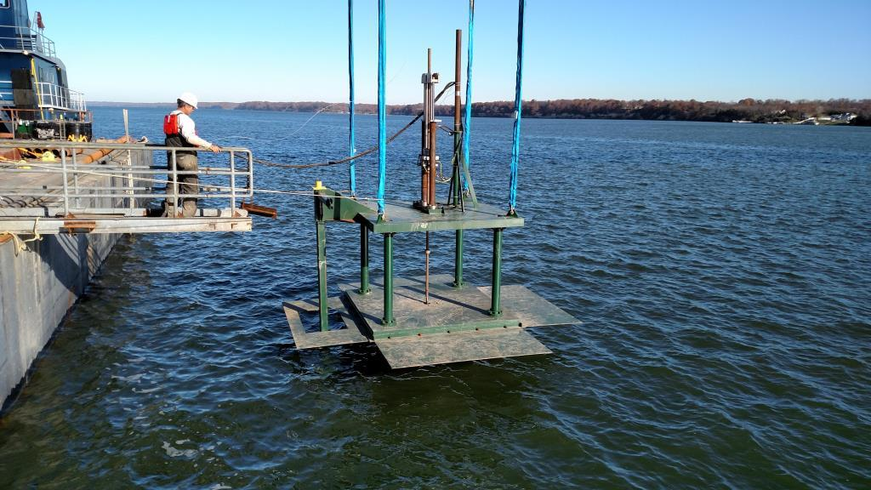
15-Ton capacity seafloor direct push system
Base area:4.7 meters by 4.7 meters to minimize settlement

Slide 54
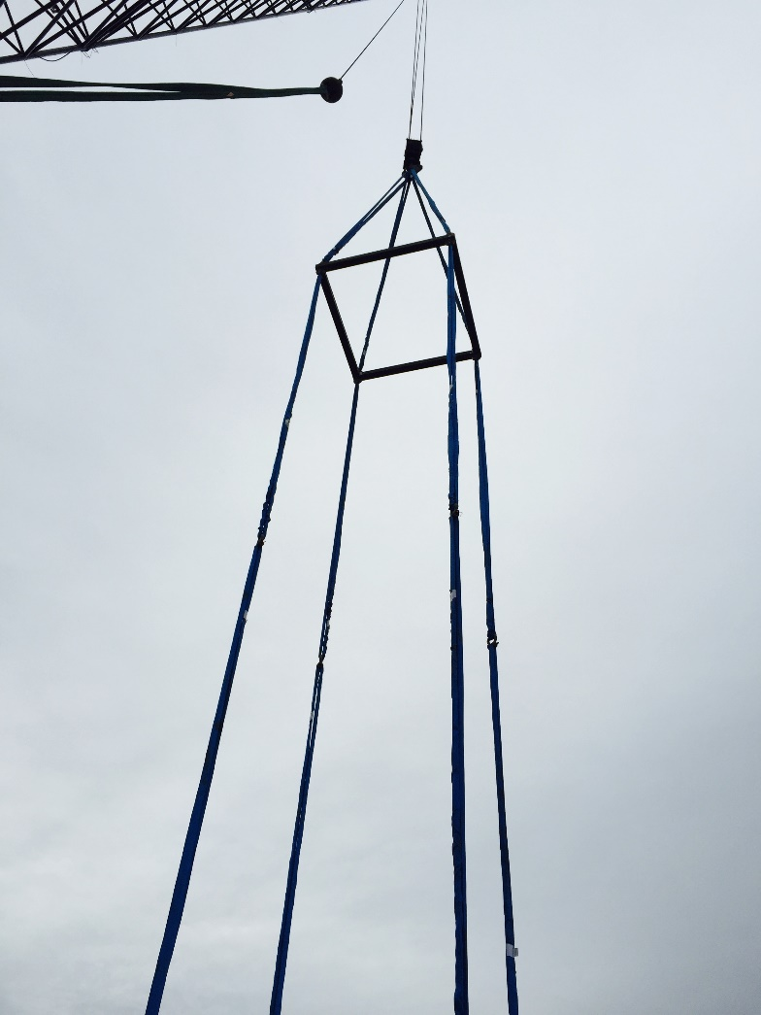
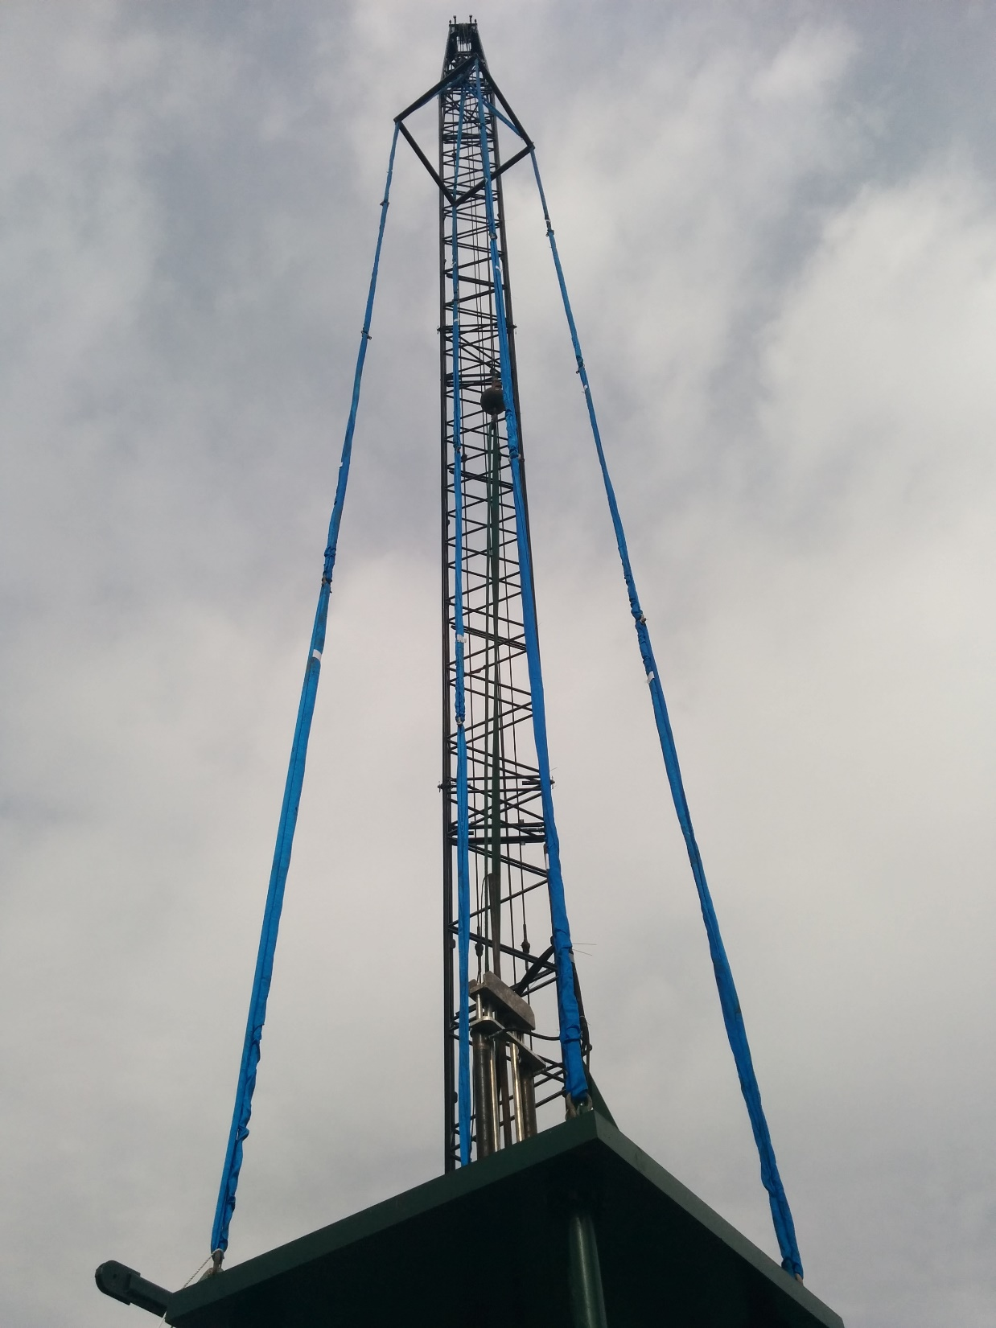

Slide 55
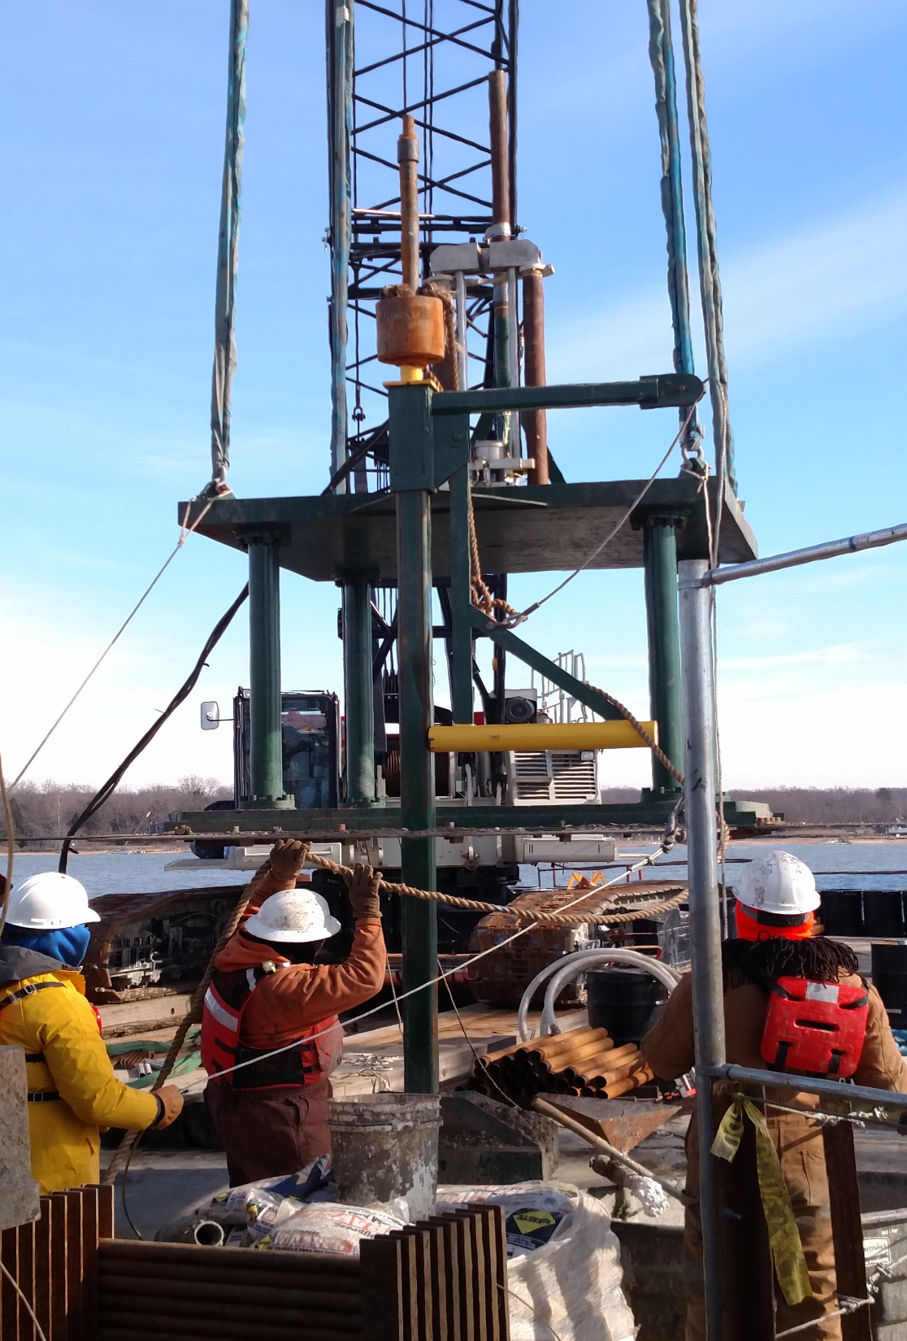
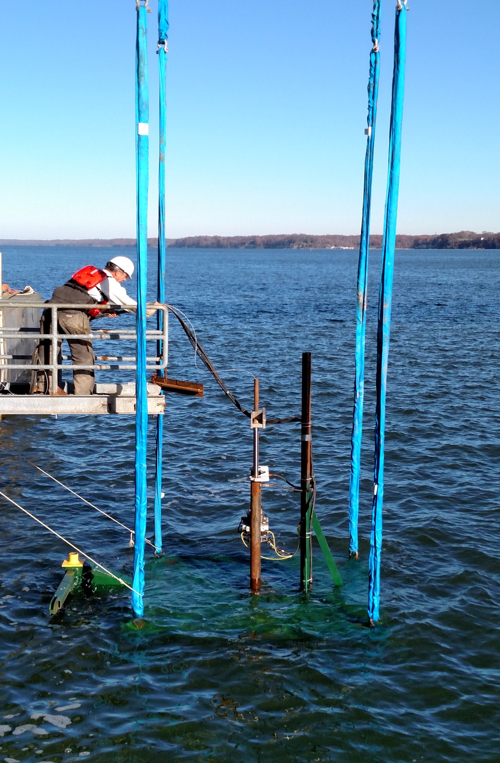
Seismic Hammer
Lowering Direct Push System

Slide 56
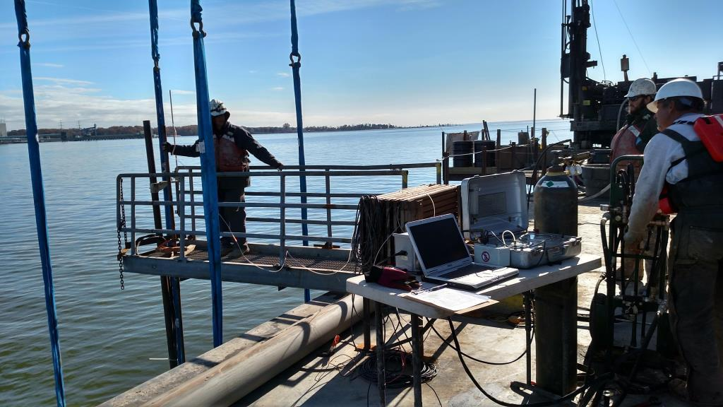
PERFORMING DILATOMETER USING SEAFLOOR SYSTEM

Slide 59
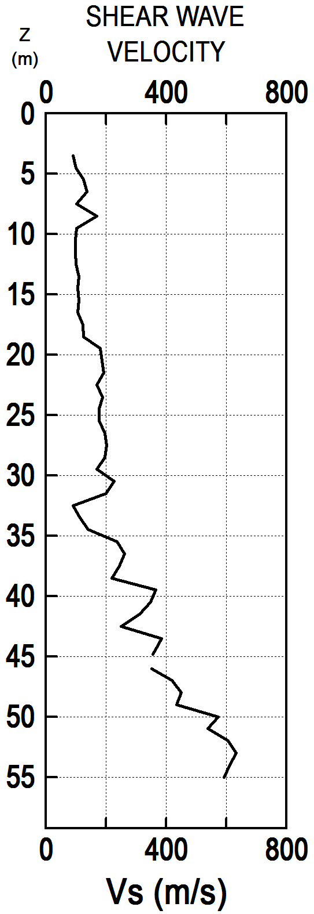

Slide 60
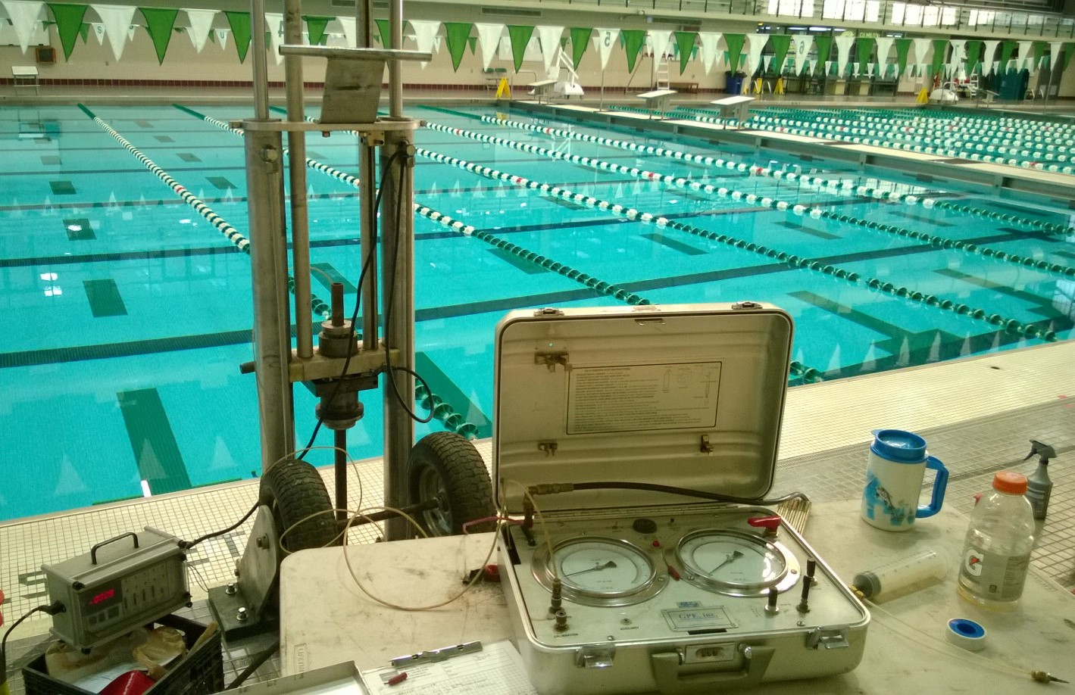
Pushing DMT with portable rig anchored to concrete slab

Slide 61
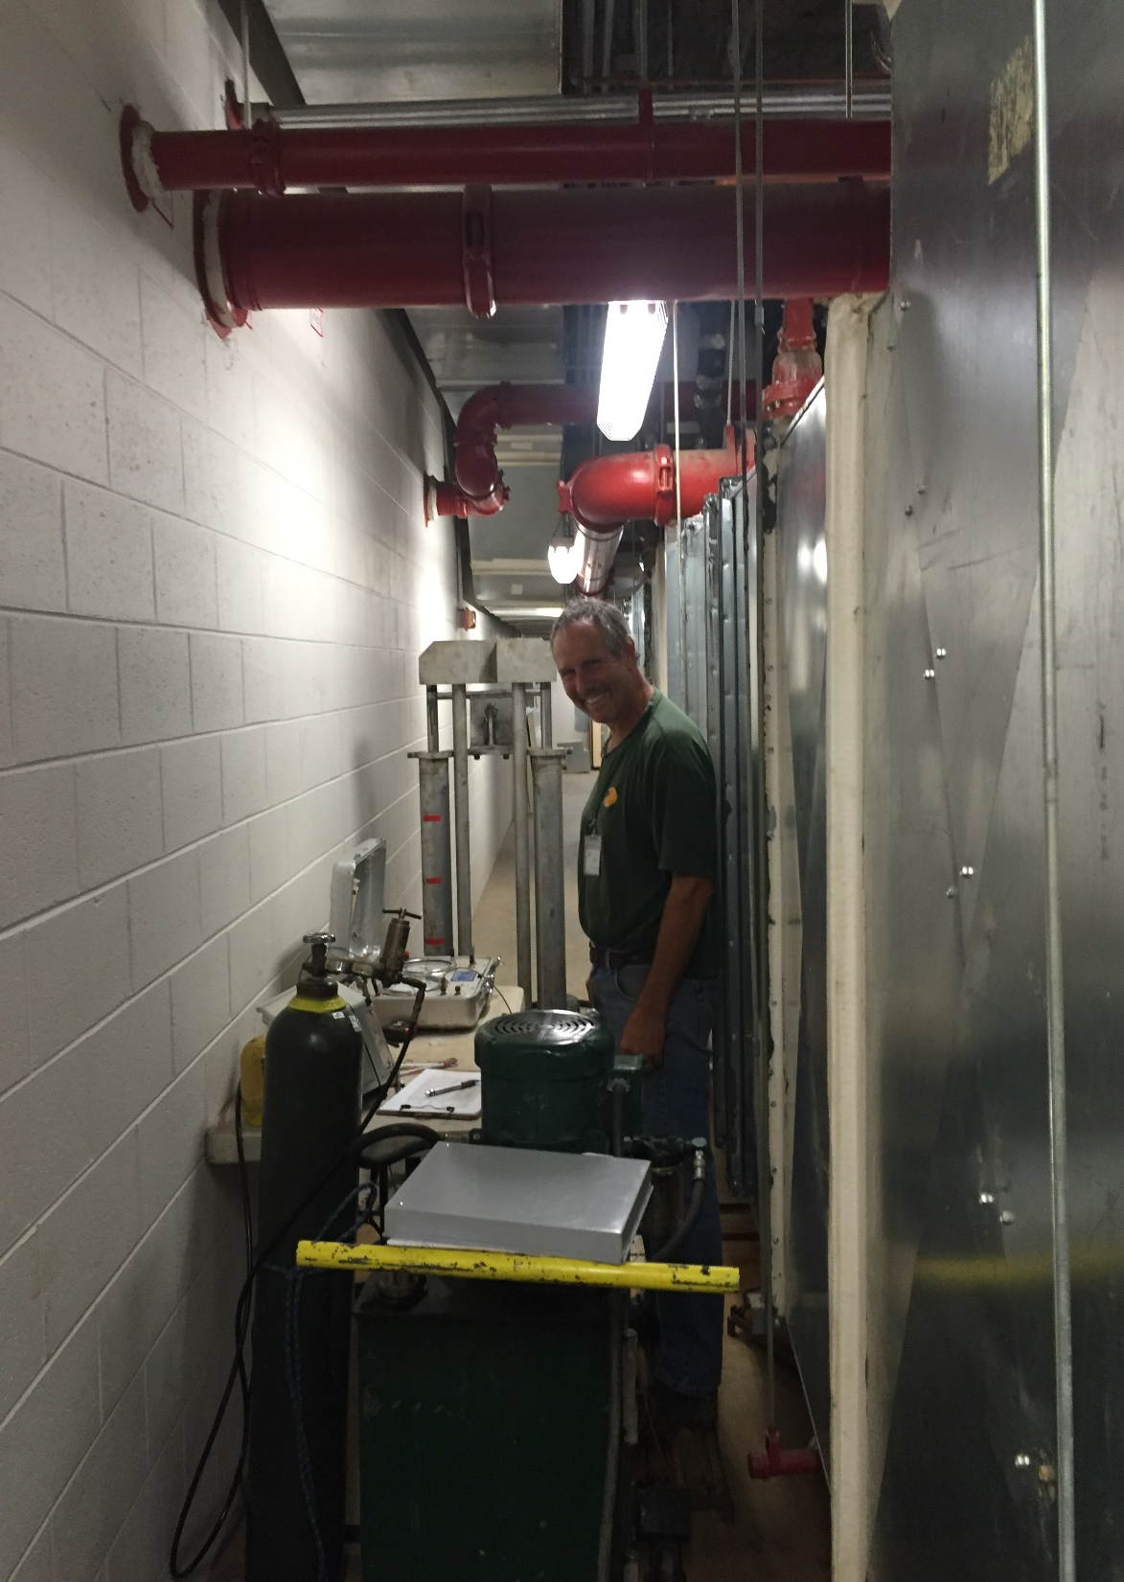
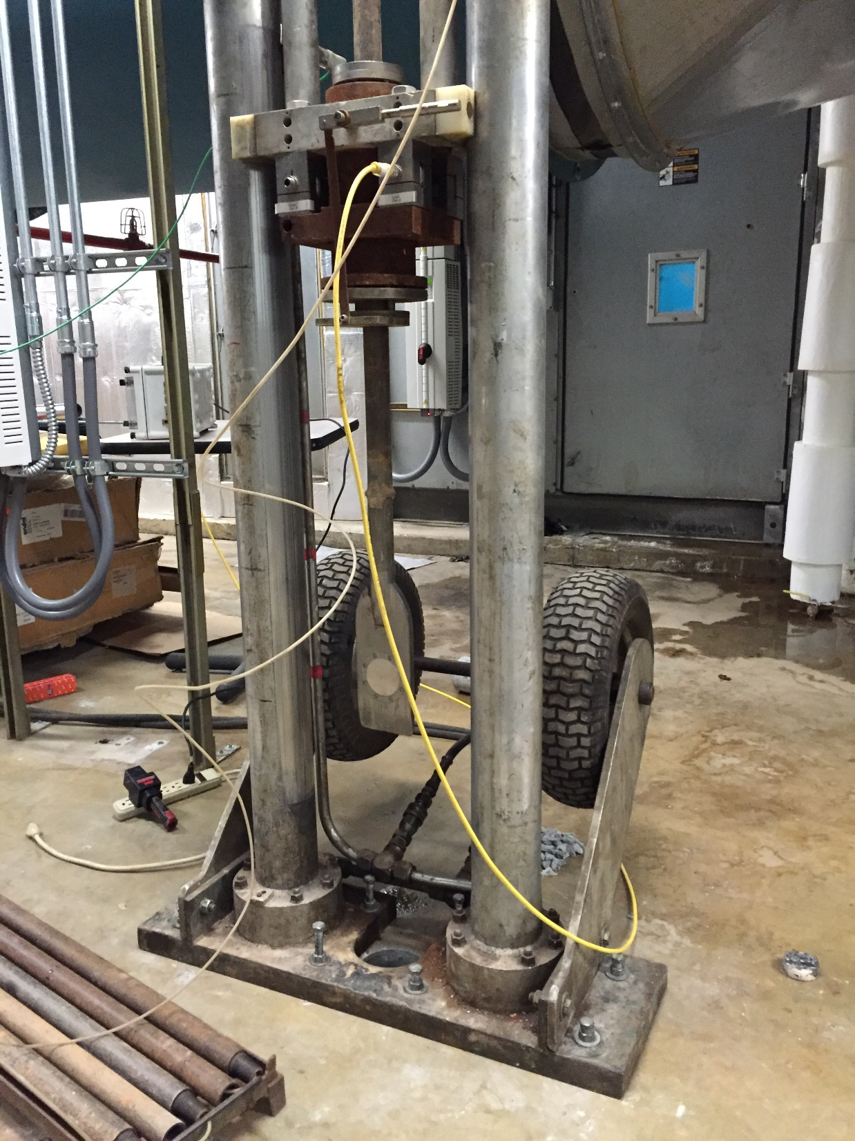

Slide 62
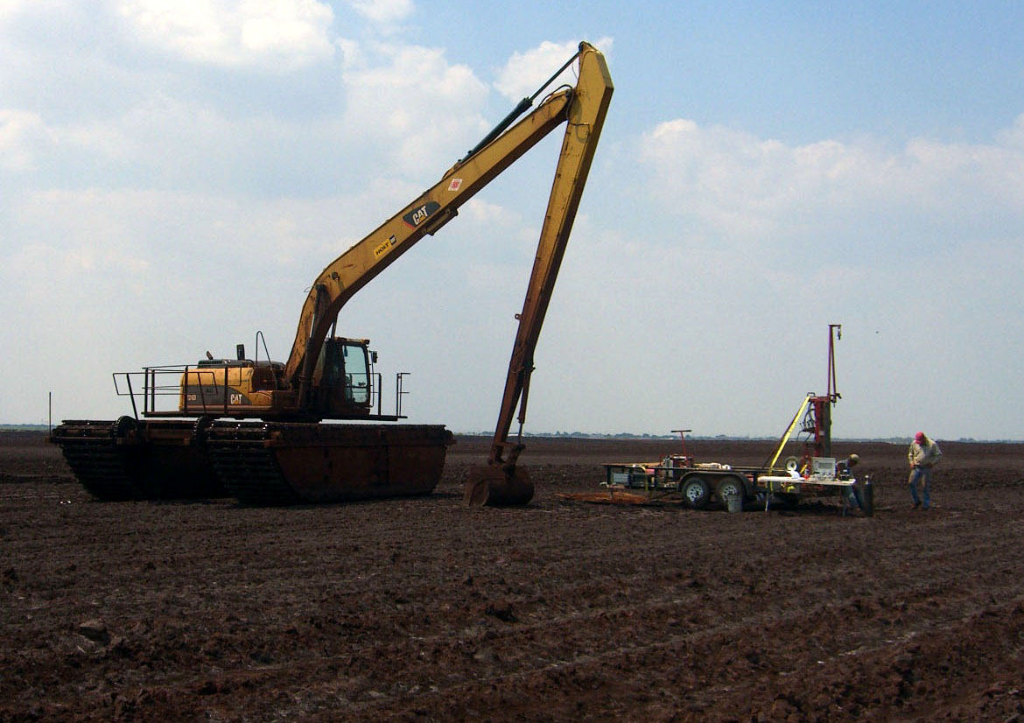
Performing DMT in a settling Pond

Slide 63
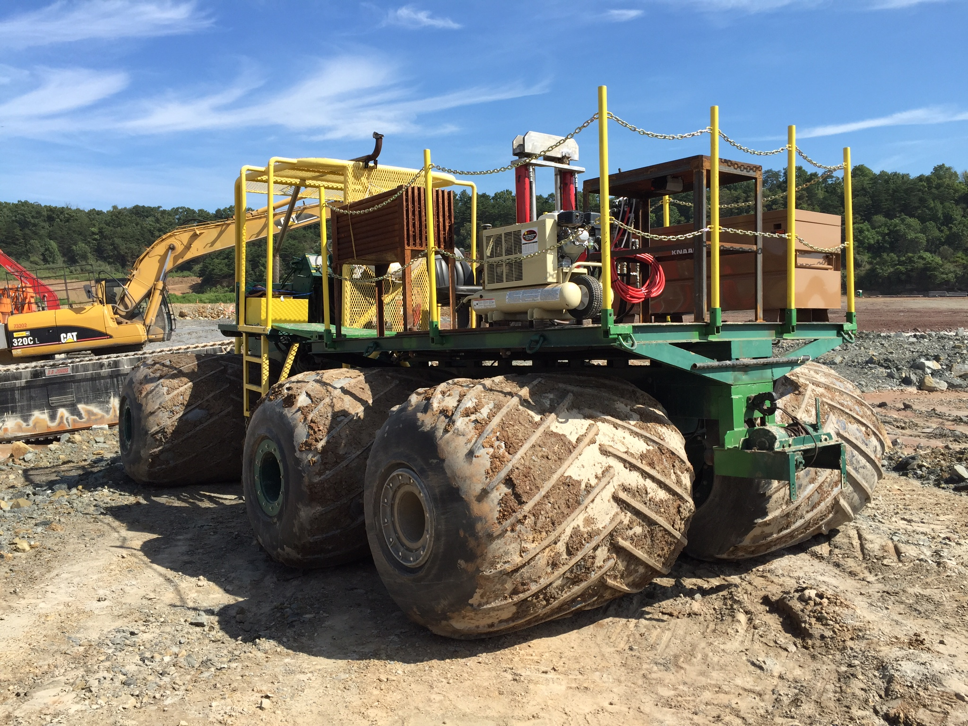

Slide 64
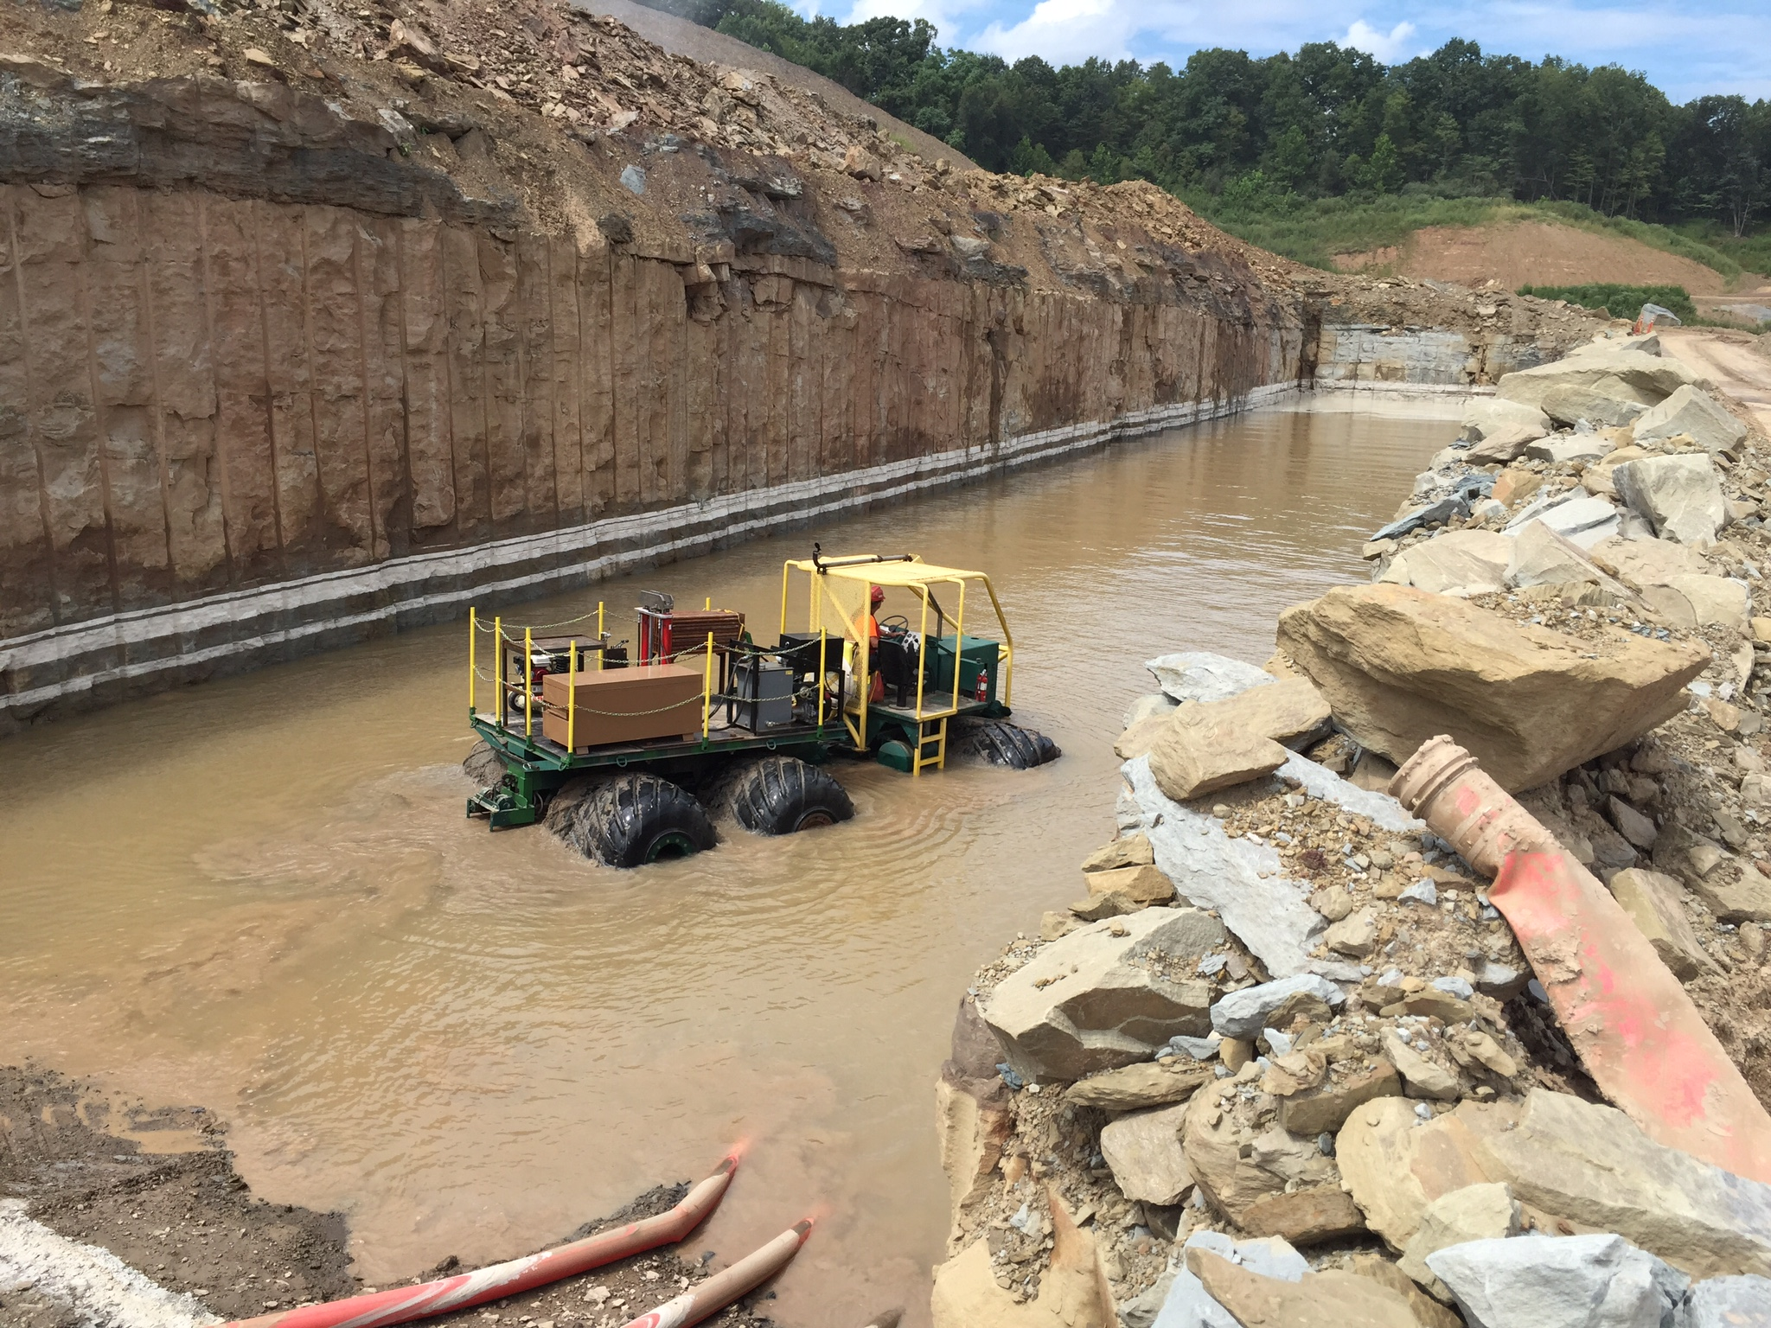

Slide 65
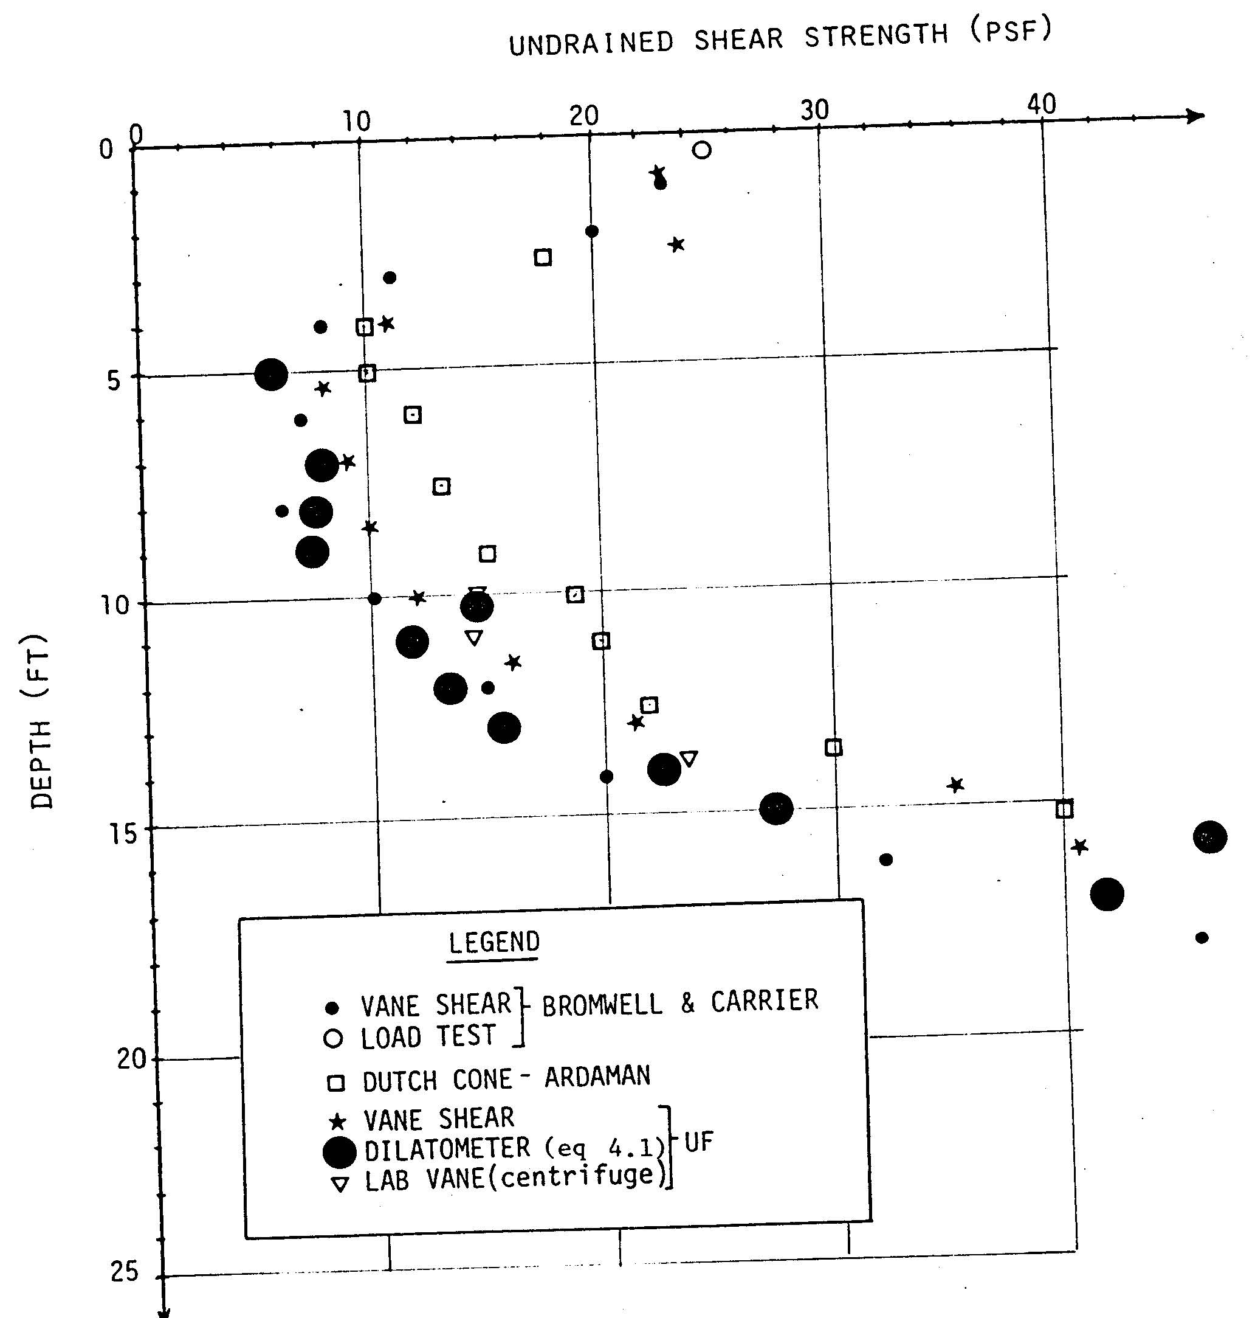
(After Bloomquist, 1988)

Slide 66
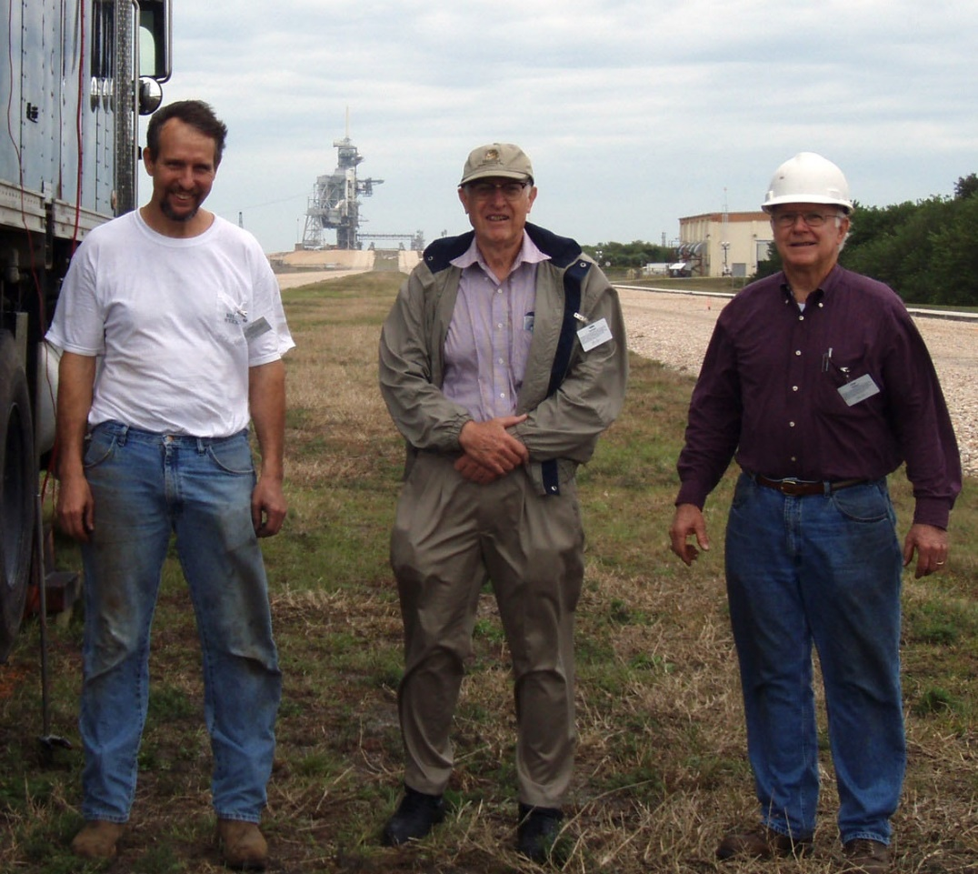
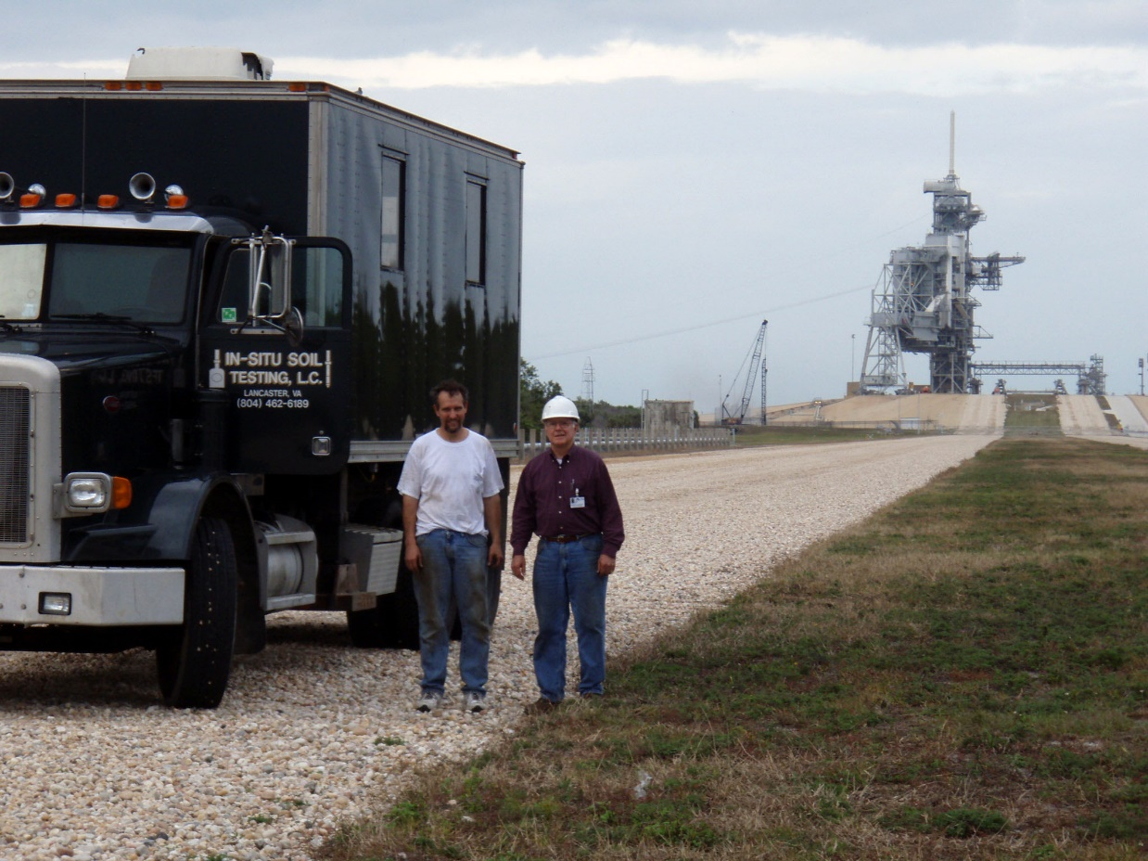
Pushing DMT with Drs. Schmertmann and Crapps at Kennedy space center

Slide 67
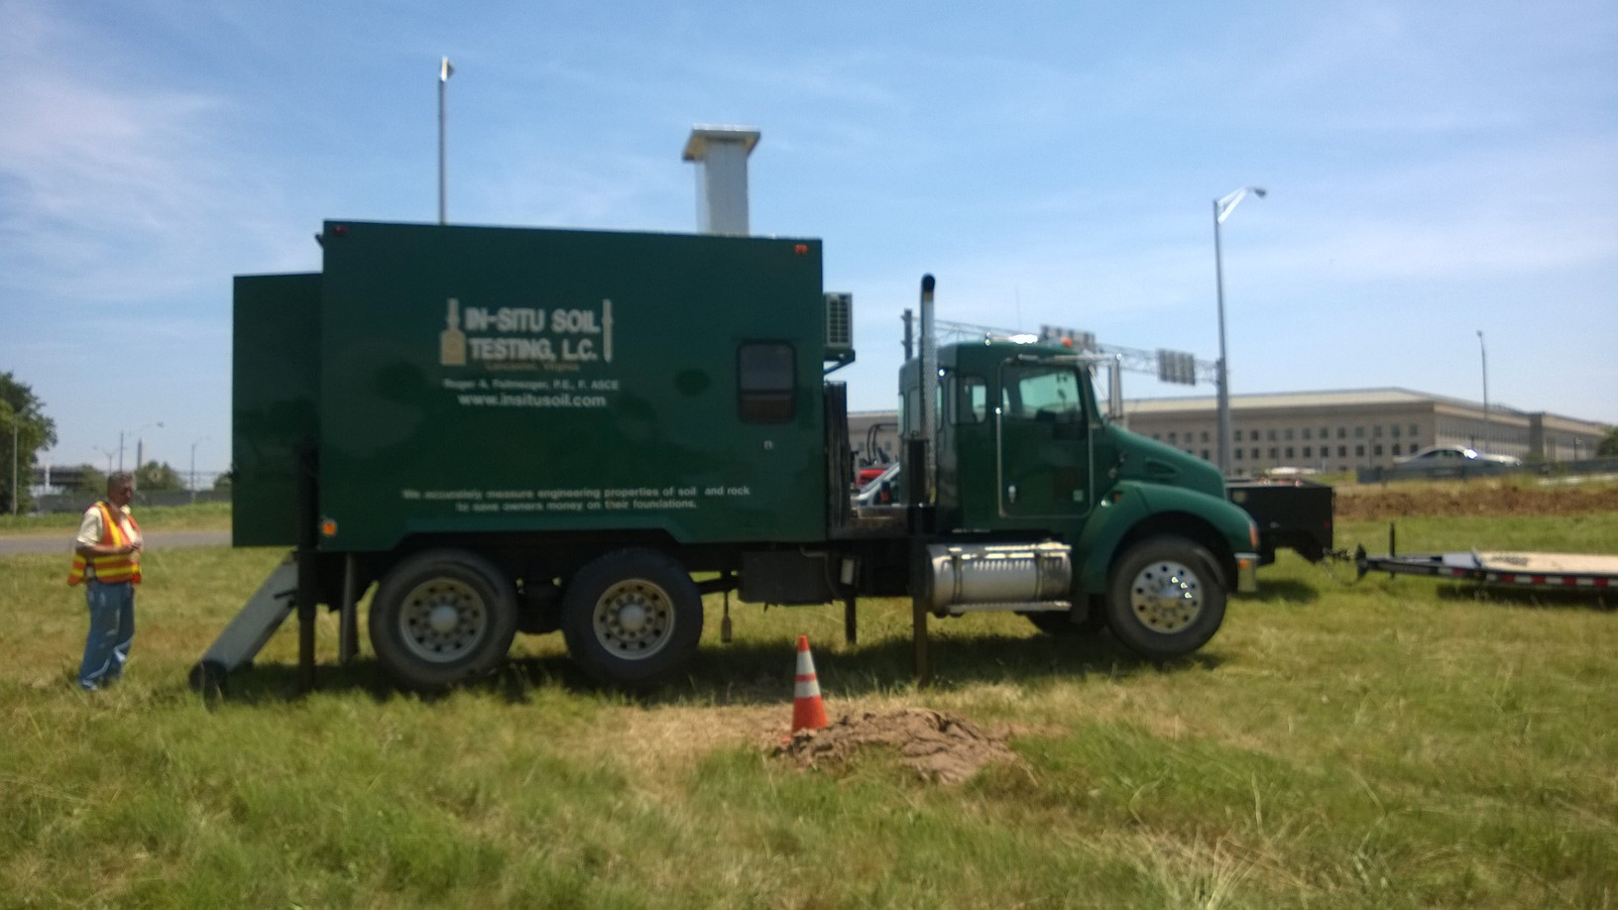
Performing DMT near pentagon

Slide 68
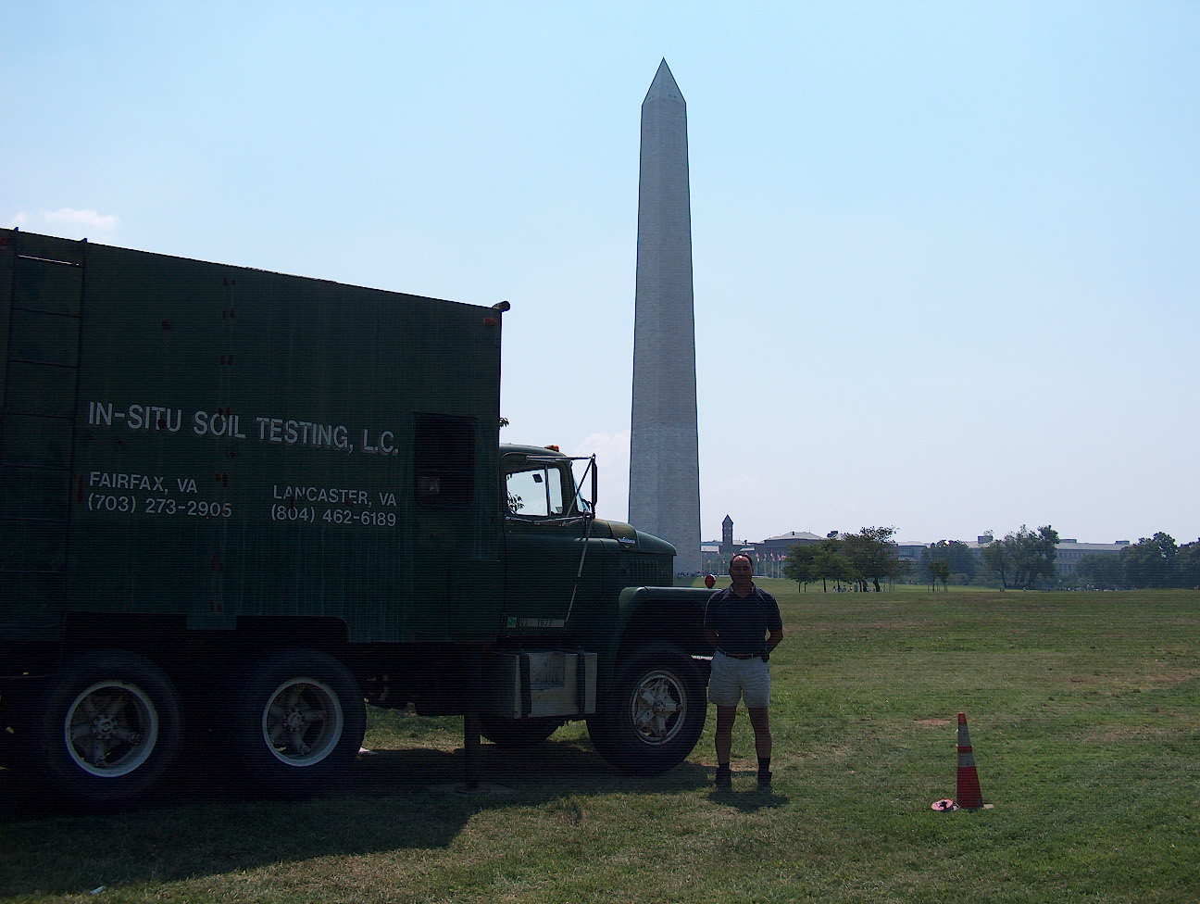

Slide 69
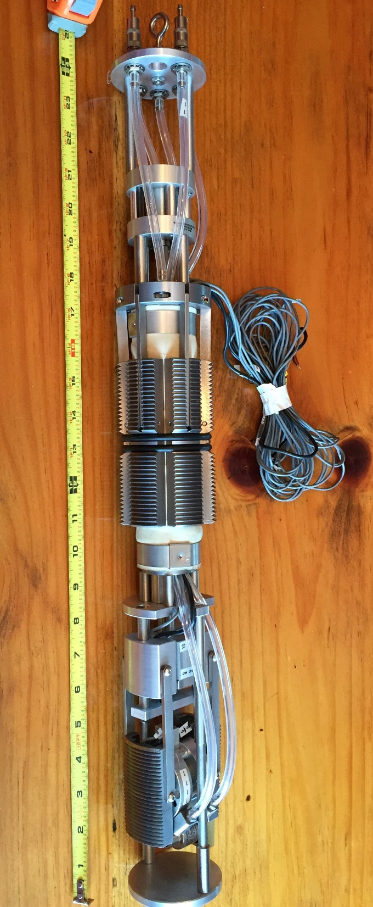
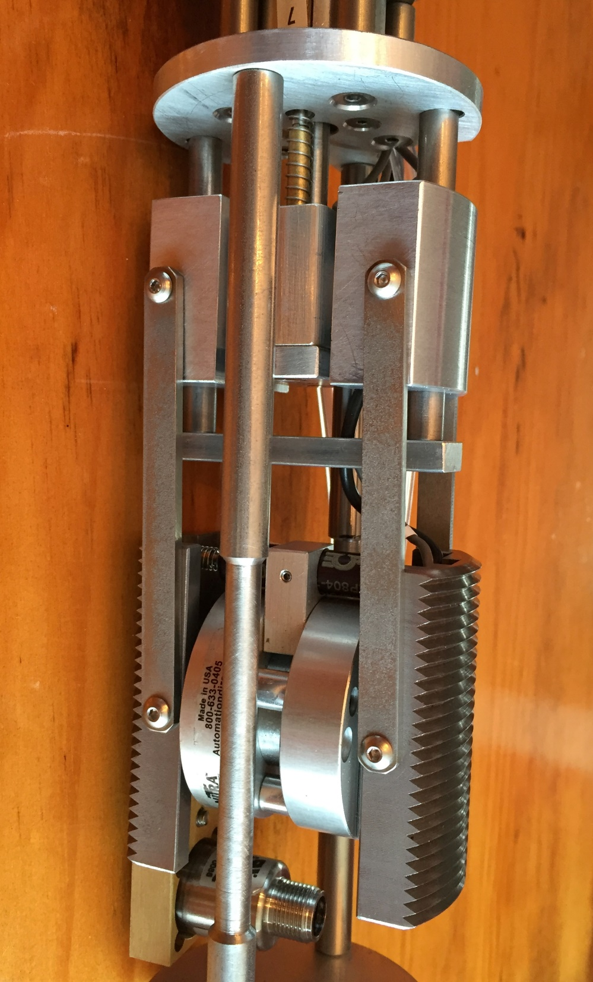
Cyclic Borehole Shear Test—like a direct shear test but uses the sidewalls as the sample

Slide 70
Conclusions
Use dilatometer tests for projects with
Settlement predictions and design of shallow foundations
Lateral load capacity of deep foundations
Drained angle of internal friction in sands (skip gravel) or undrained shear strength in cohesive soil
Excellent data trending and test repeatability
Gives engineer good understanding of the site geology and how the soil will perform
Significantly increases engineer’s confidence
Settlement predictions quite good—have not received any phone calls where my prediction was too low (20+ years)
With thrust—can estimate “A”
With thrust and “A”—can estimate “B”
My favorite overall in-situ test because of its accuracy

